Slide 1
Mystery – What happened ??
Bible says generally to avoid conflict
But, at times, Jesus deliberately stirred conflict
  He opposed the Pharisees & scribes directly & with energy
  He didn’t invite them to a friendly exchange of ideas
  He accused them of being hypocrites
  When He first entered Jerusalem, He went straight to their turf – the Temple grounds
  The week before, He challenged them repeatedly in Matt 23
    Their words had the authority of Moses, but their acts did not
These were national spiritual leaders – what happened ??
And why didn’t the people recognize Jesus as their Messiah, & override the Pharisees ??
It is necessary to go back 400 years to see the buildup to these conditions

Slide 2
THE FOUR HUNDRED
SILENT YEARS

Slide 3
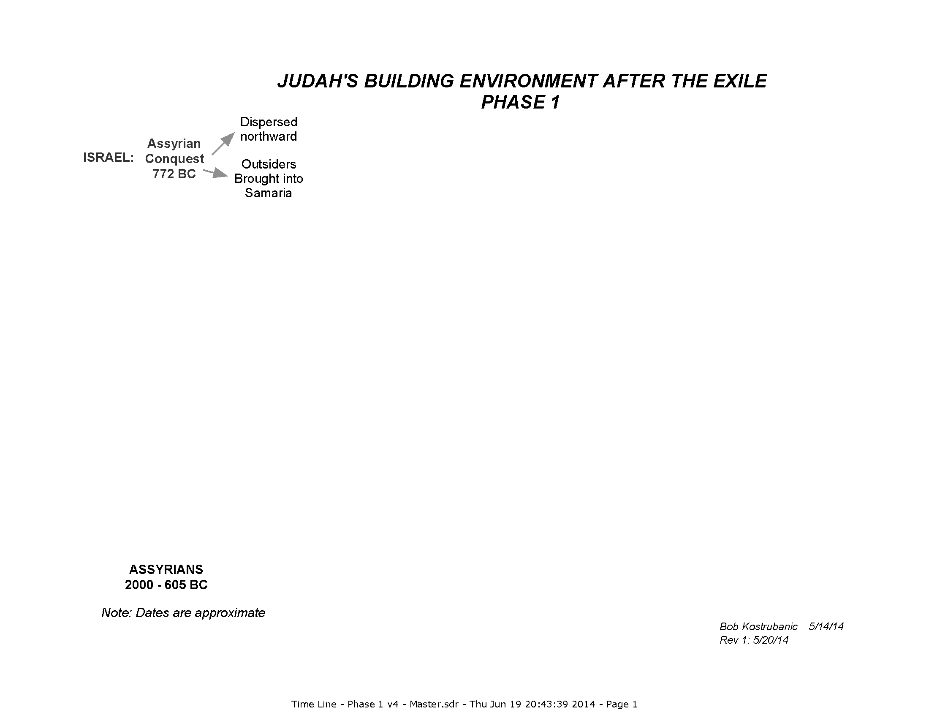

Slide 4
Israel (Northern Tribes) taken away
1 Chron 5.25-26
“25 But they acted treacherously against the God of their fathers and played the harlot after the gods of the peoples of the land, whom God had destroyed before them.
26 So the God of Israel stirred up the spirit of Pul, king of Assyria, even the spirit of Tilgath-pilneser king of Assyria, and he carried them away into exile, namely the Reubenites, the Gadites and the half-tribe of Manasseh, and brought them to Halah, Habor, Hara and to the river of Gozan, to this day.”
2 Ki 17.24-29
“24 The king of Assyria brought men from Babylon and from Cuthah and from Avva and from Hamath and Sephar- vaim, and settled them in the cities of Samaria in place of the sons of Israel. So they possessed Samaria and lived in its cities.
25 At the beginning of their living there, they did not fear the Lord; therefore the Lord sent lions among them which killed some of them.
26 So they spoke to the king of Assyria, saying, “The nations whom you have carried away into exile in the cities of Samaria do not know the custom of the god of the land; so he has sent lions among them, and behold, they kill them because they do not know the custom of the god of the land.”
27 Then the king of Assyria commanded, saying, “Take there one of the priests whom you carried away into exile and let him go and live there; and let him teach them the custom of the god of the land.”
28 So one of the priests whom they had carried away into exile from Samaria came and lived at Bethel, and taught them how they should fear the Lord.
29 But every nation still made gods of its own and put them in the houses of the high places which the people of Samaria had made, every nation in their cities in which they lived.”

Slide 5
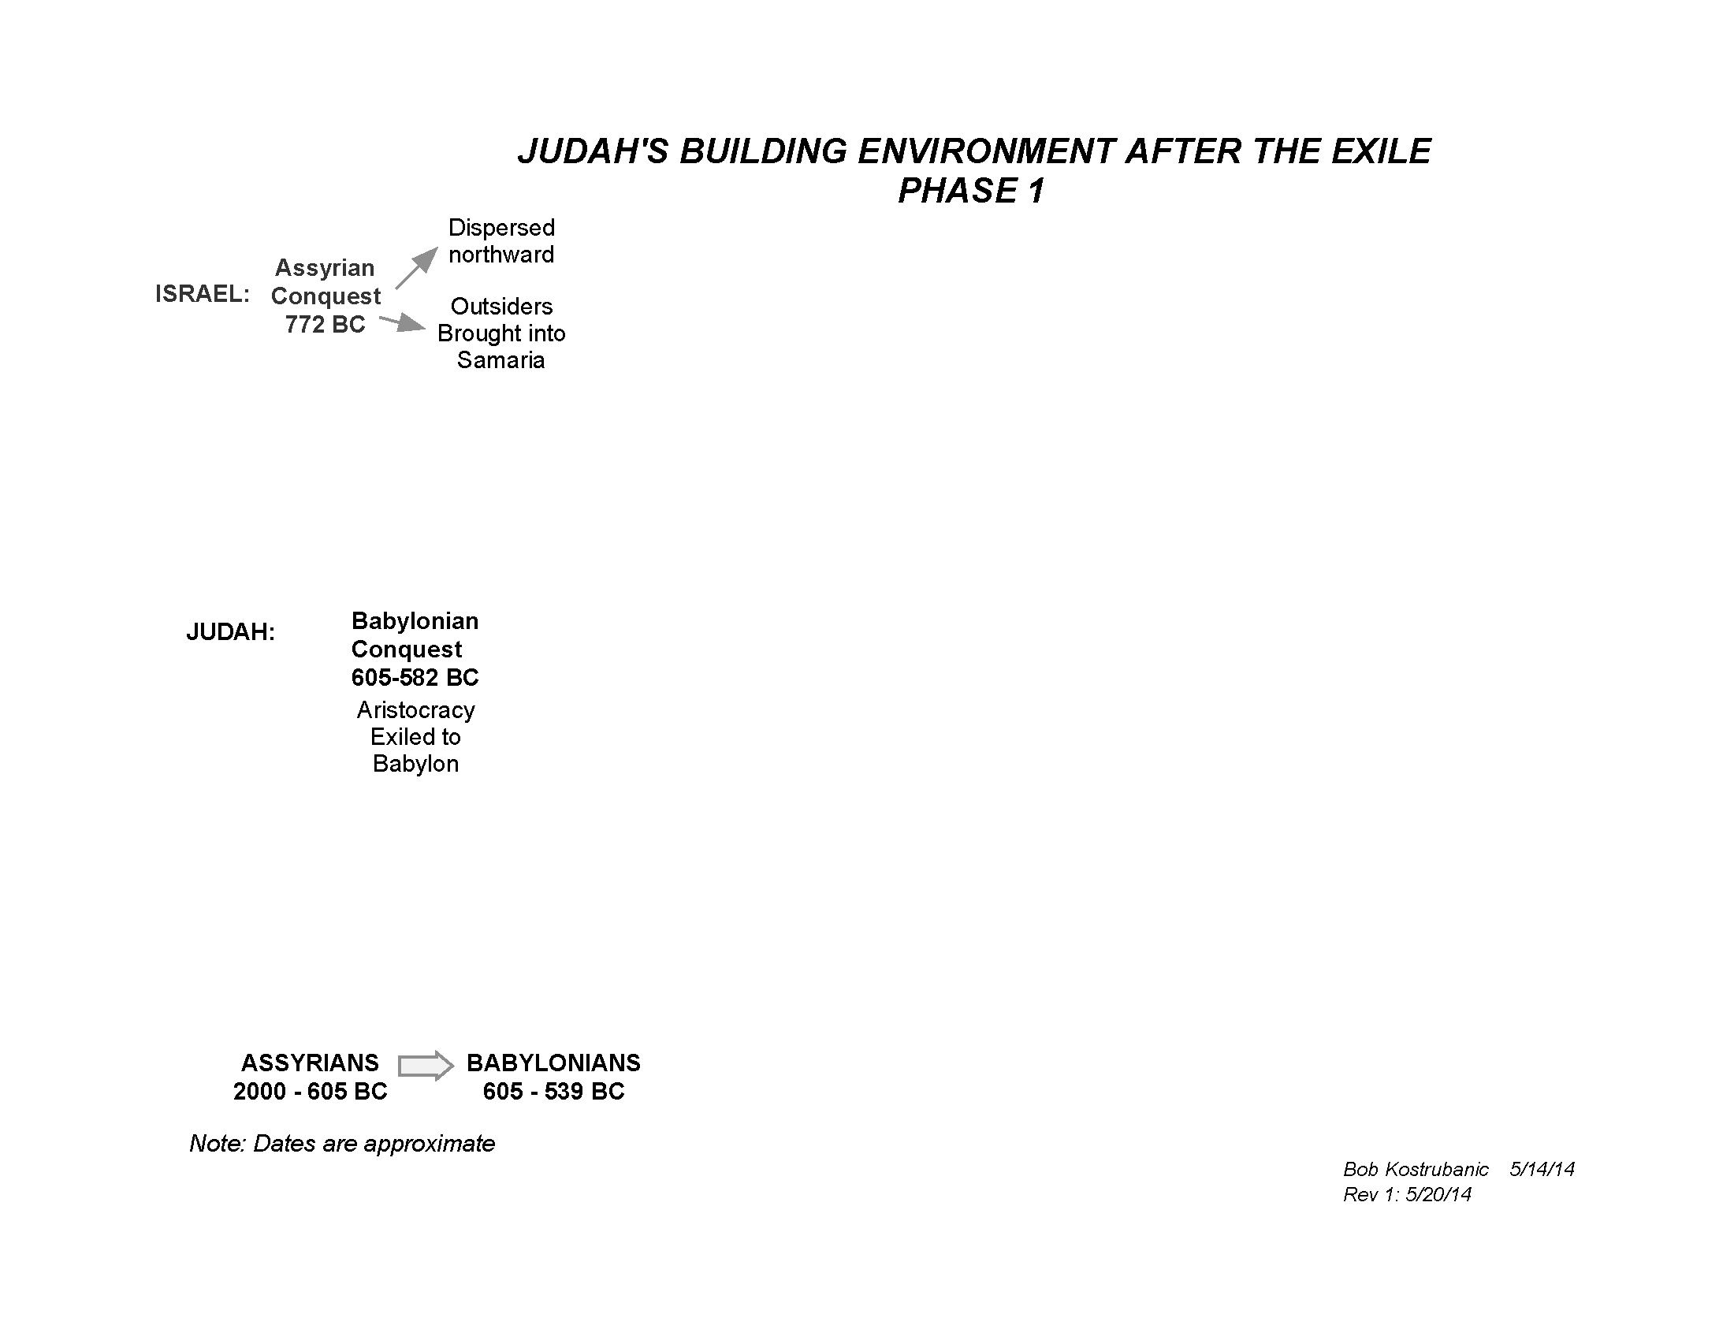

Slide 6
Judah (Southern Tribes) taken away
2 Ki 24.14
“Then he led away into exile all Jerusalem and all the captains and all the mighty men of valor, ten thousand captives, and all the craftsmen and the smiths. None remained except the poorest people of the land”

Slide 7
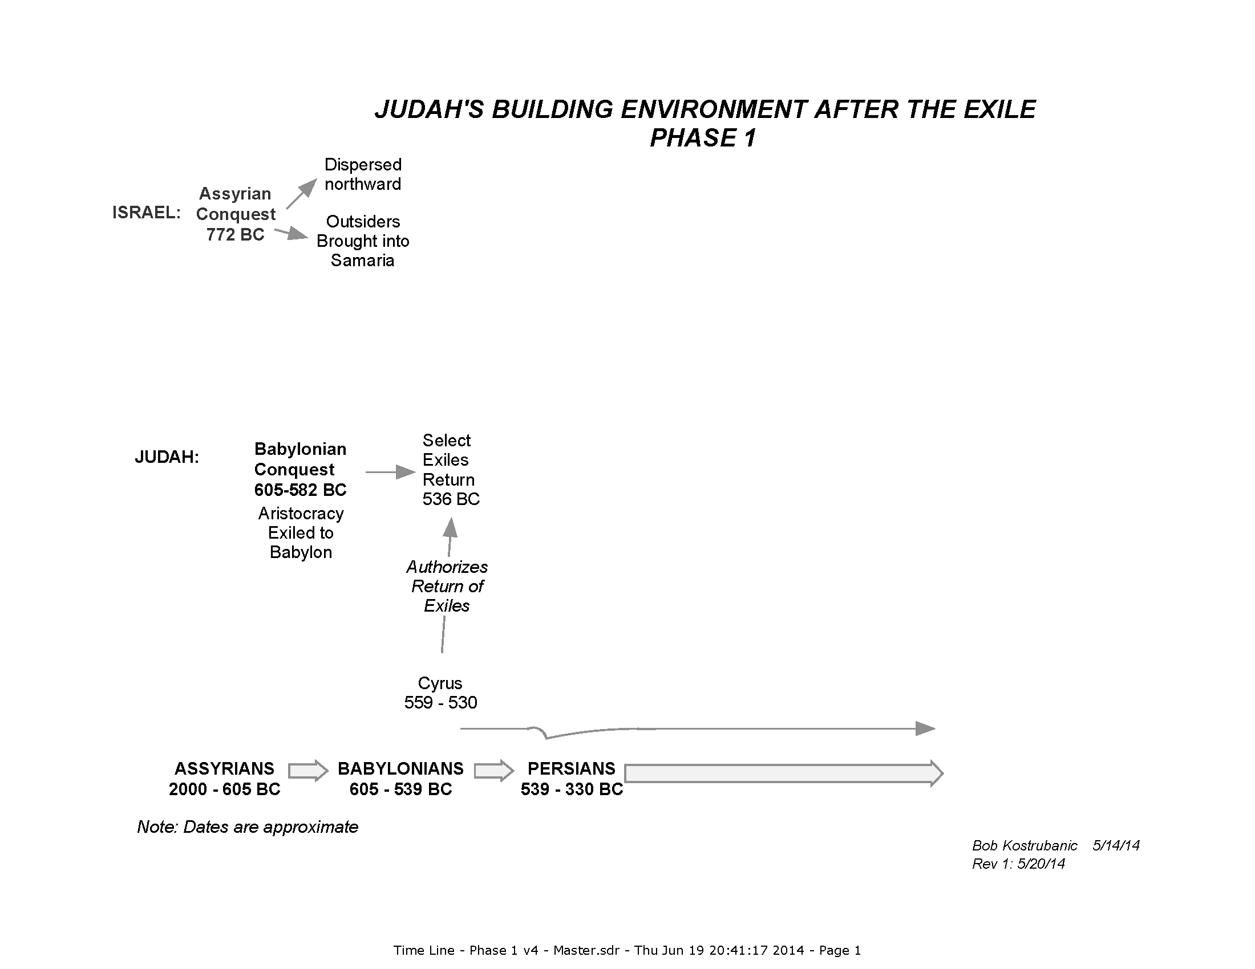

Slide 8
The Exiles permitted to return
Cyrus’ proclamation …
2 Chr 36.22-23
“22 Now in the first year of Cyrus king of Persia—in order to fulfill the word of the Lord by the mouth of Jeremiah—the Lord stirred up the spirit of Cyrus king of Persia, so that he sent a proclamation throughout his kingdom, and also put it in writing, saying,
23 “Thus says Cyrus king of Persia, ‘The Lord, the God of heaven, has given me all the kingdoms of the earth, and He has appointed me to build Him a house in Jerusalem, which is in Judah. Whoever there is among you of all His people, may the Lord his God be with him, and let him go up!’ ”

Slide 9
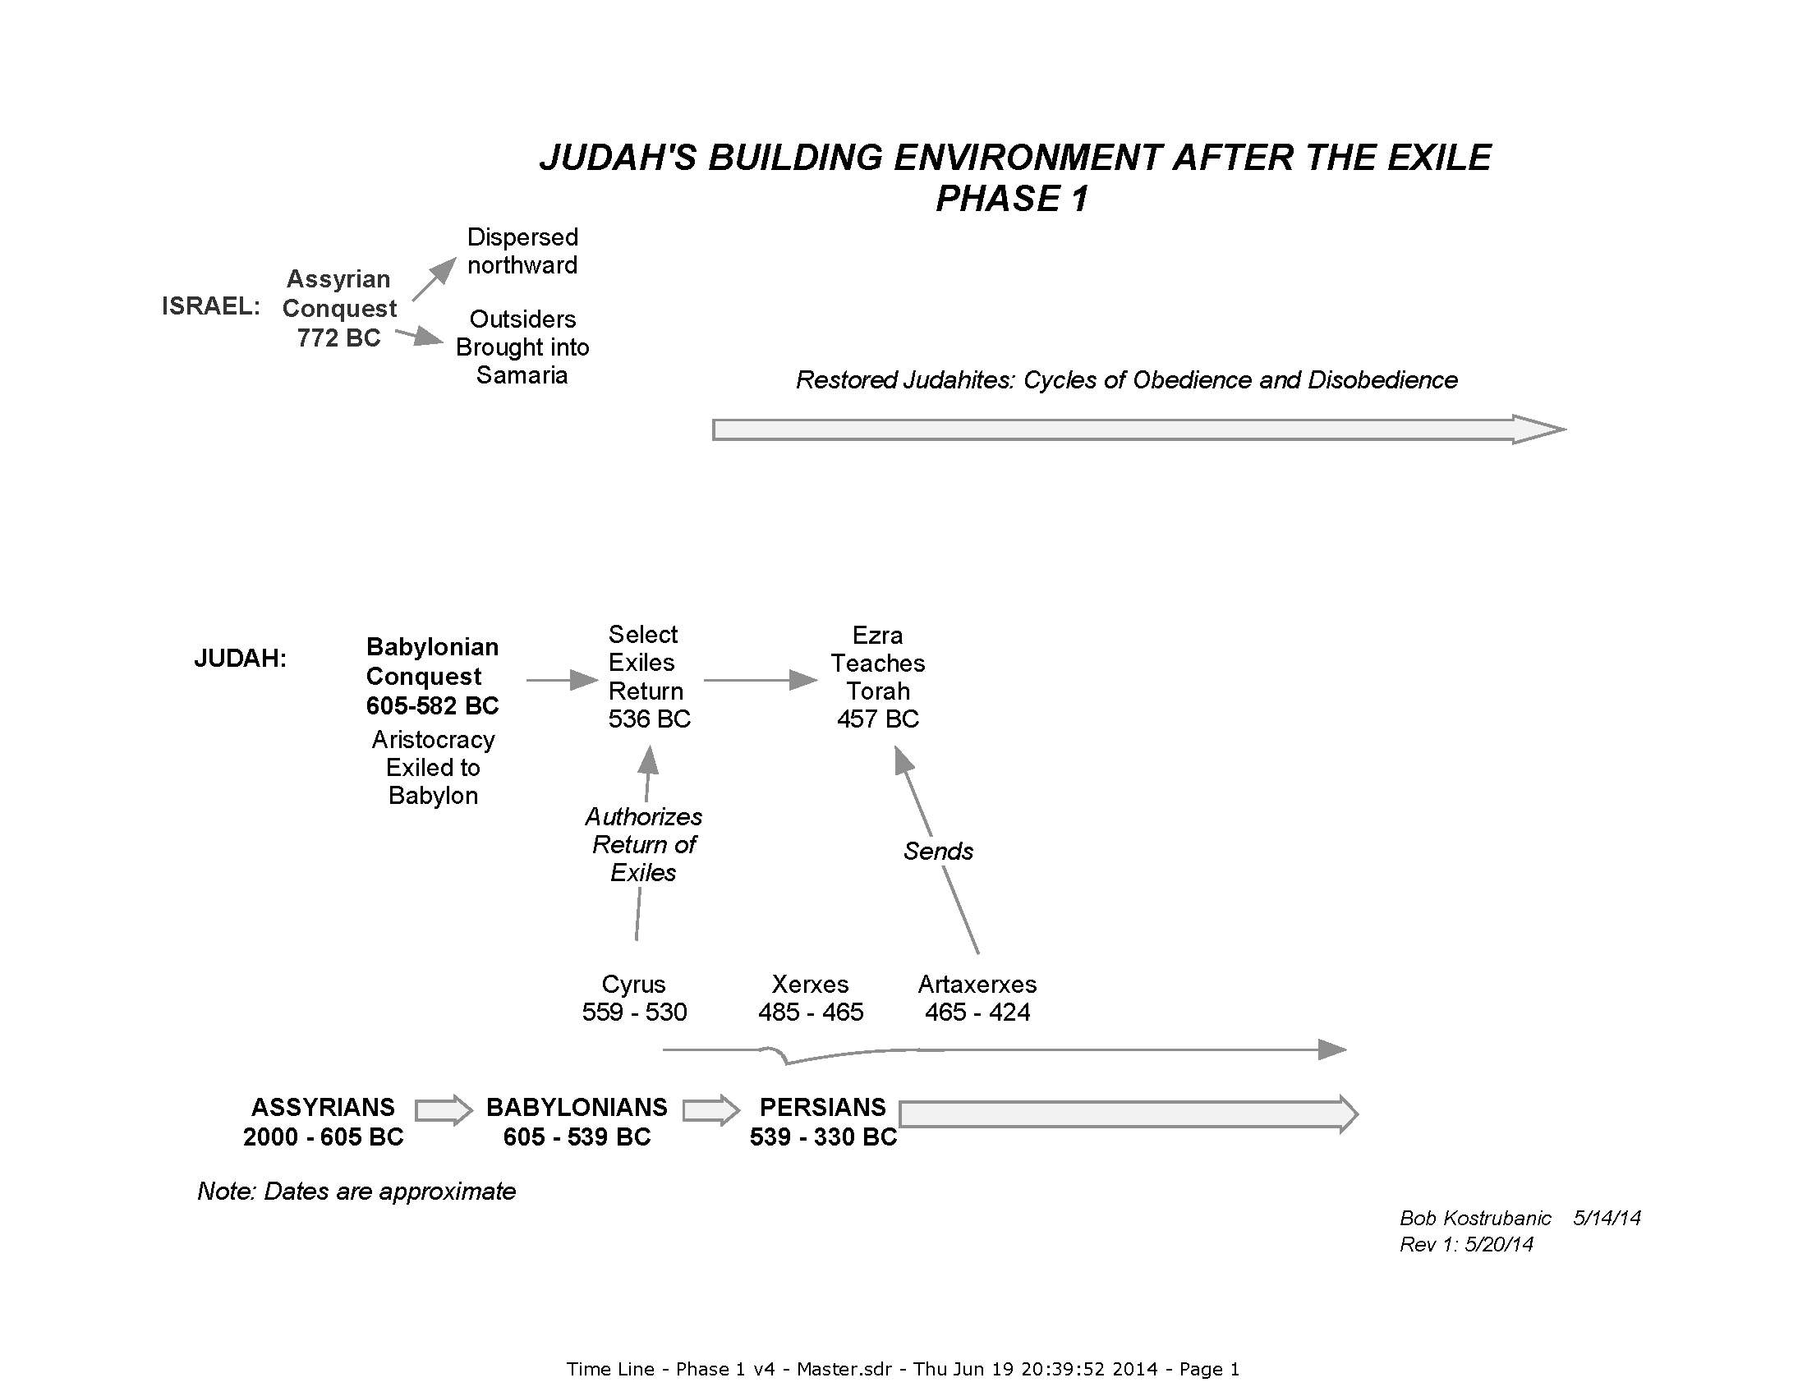

Slide 10
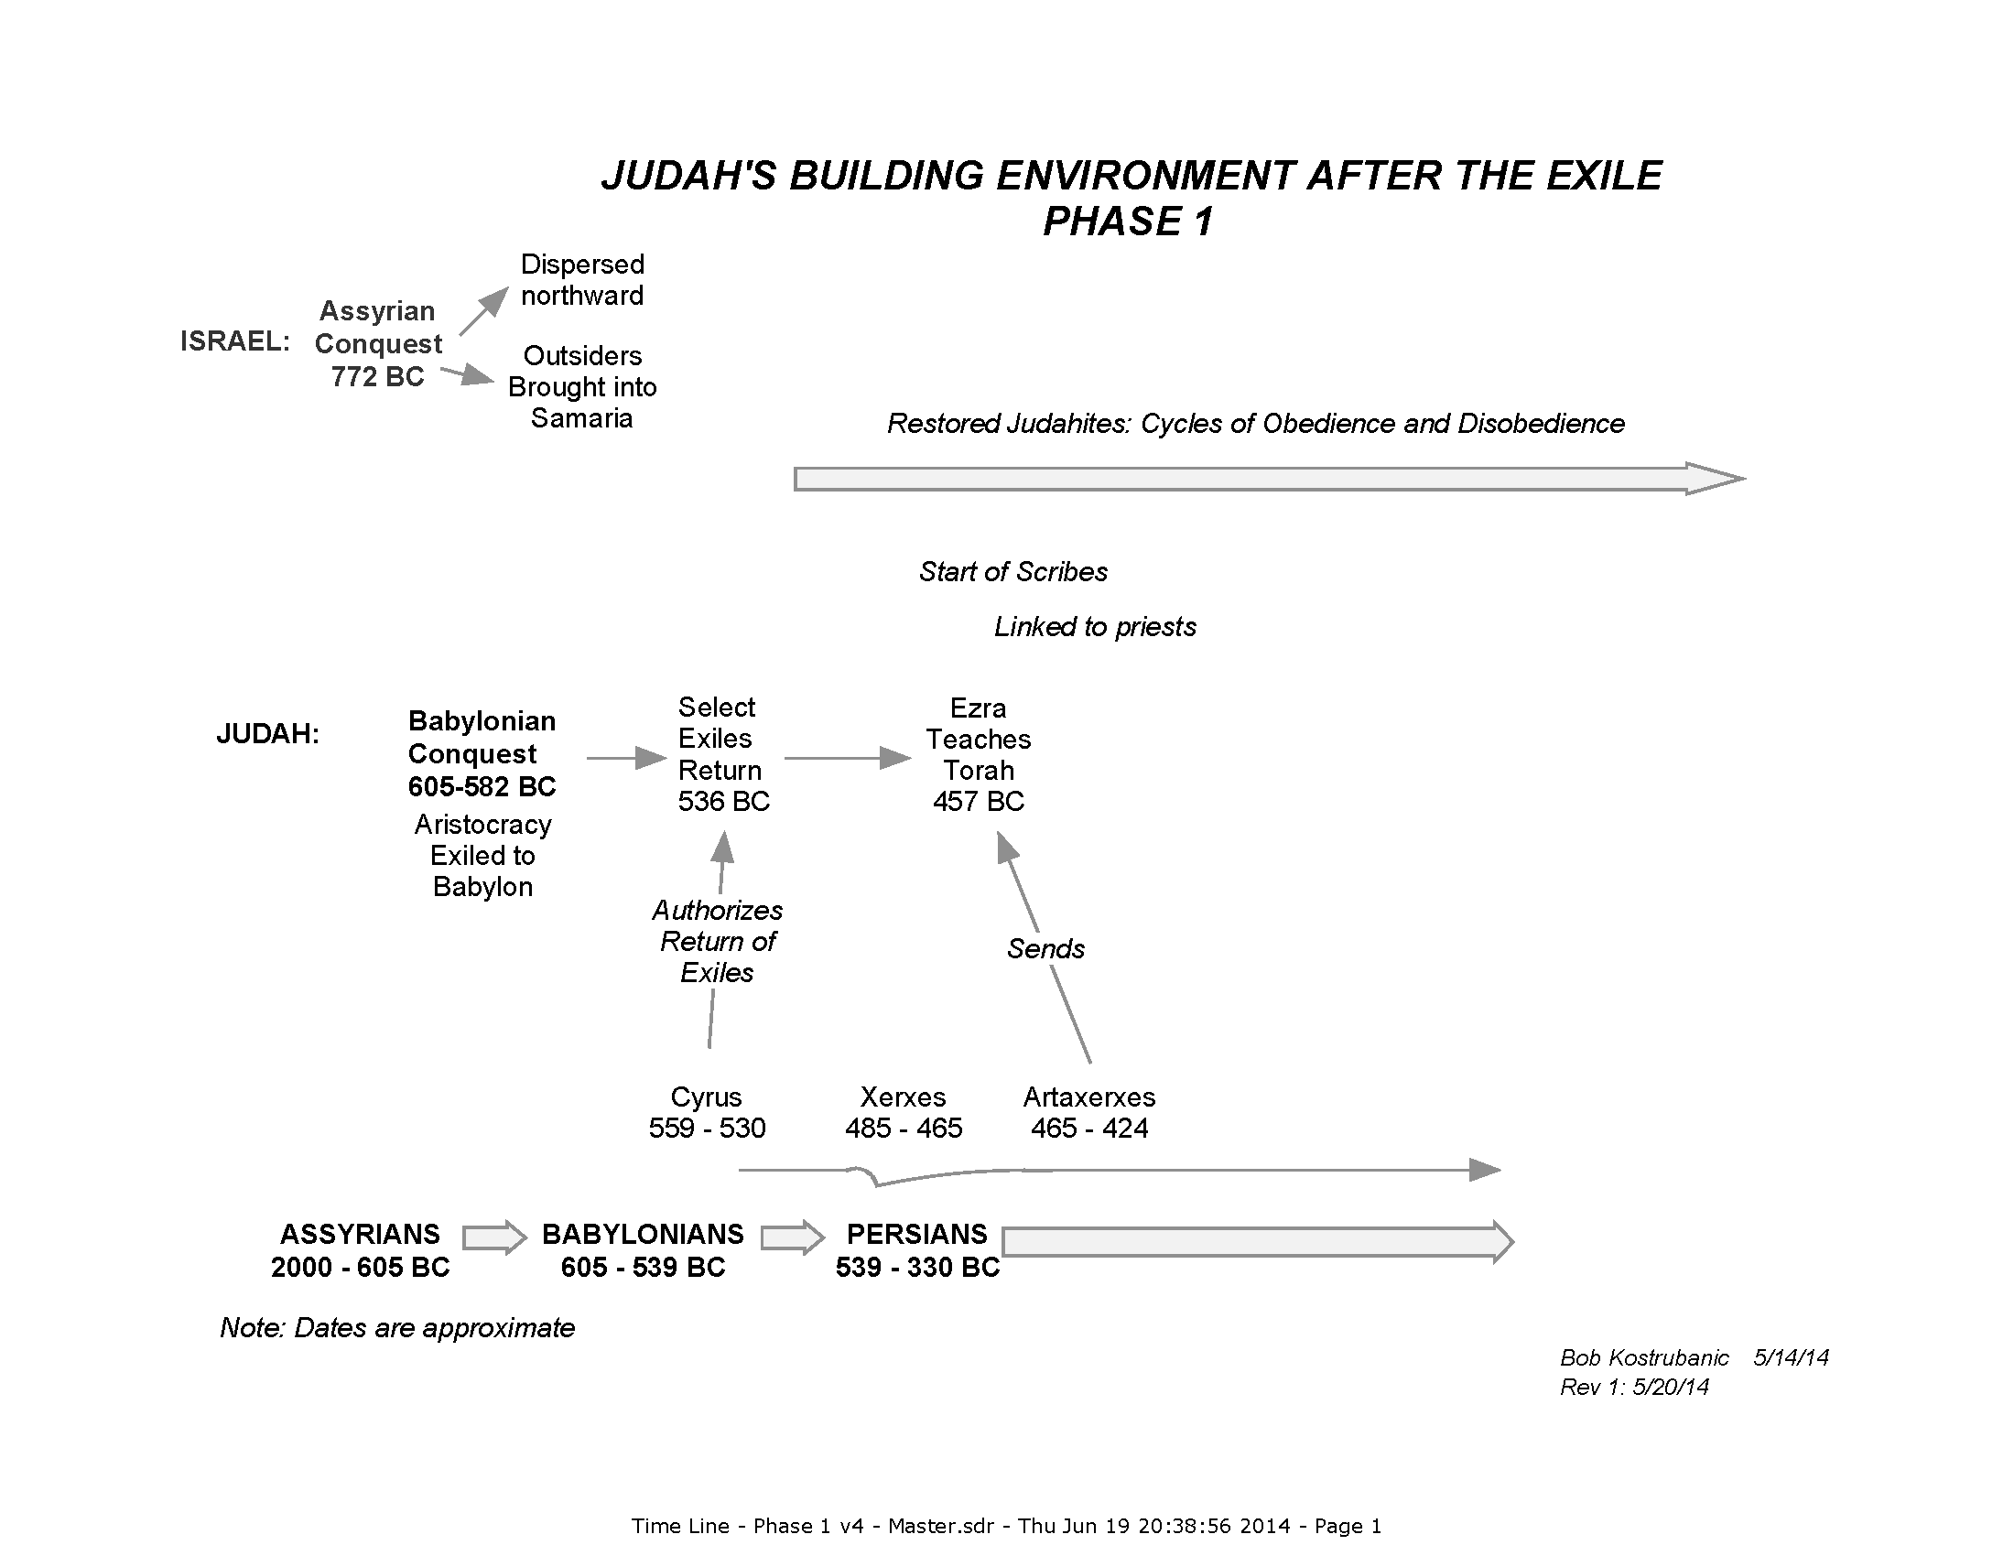

Slide 11
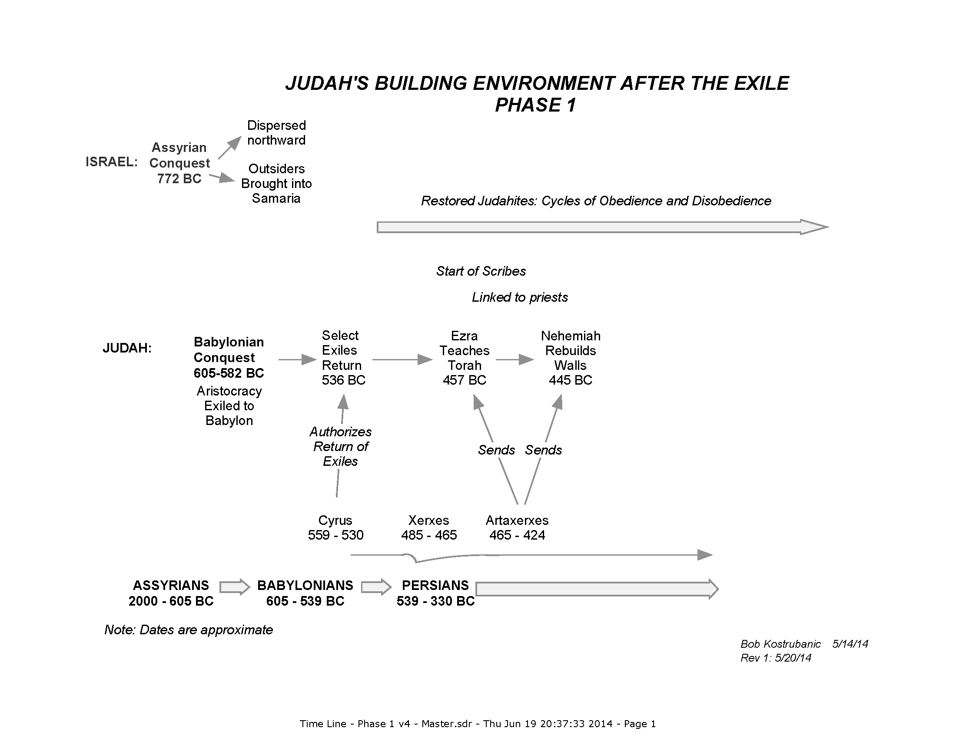

Slide 12
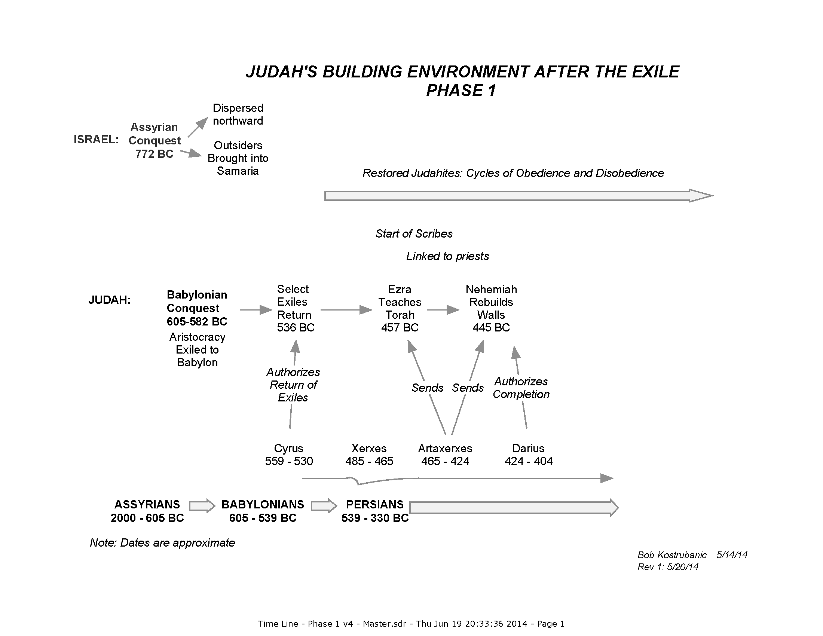

Slide 13
The Jews under priestly rule
Nehemiah worked to keep the idolatrous world surrounding Judah from coming in
Both the Persians & the following Greeks exercised mild rule over the Jews
Both delegated authority to the high priest
  Jeshua served in the temple reconstruction 515 – 490 BC, came from Babylon with Zerubbabel
  Eliashib under Nehemiah
  But his son, Joiada, encouraged intermarrying with idolatrous nations surrounding them
  Jaddua confronted Alexander the Great as he approached Jerusalem

Slide 14
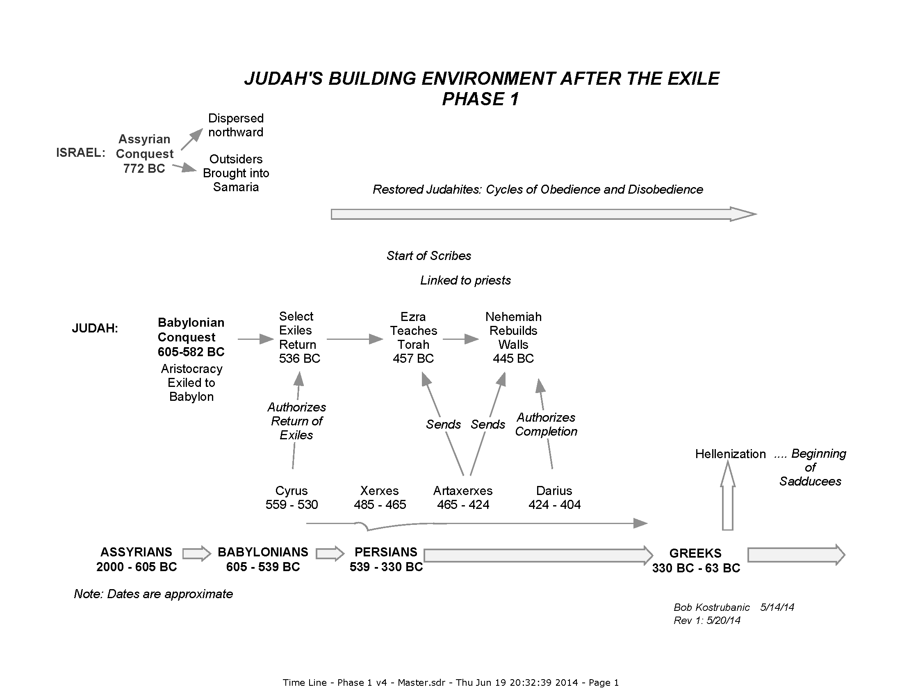

Slide 15
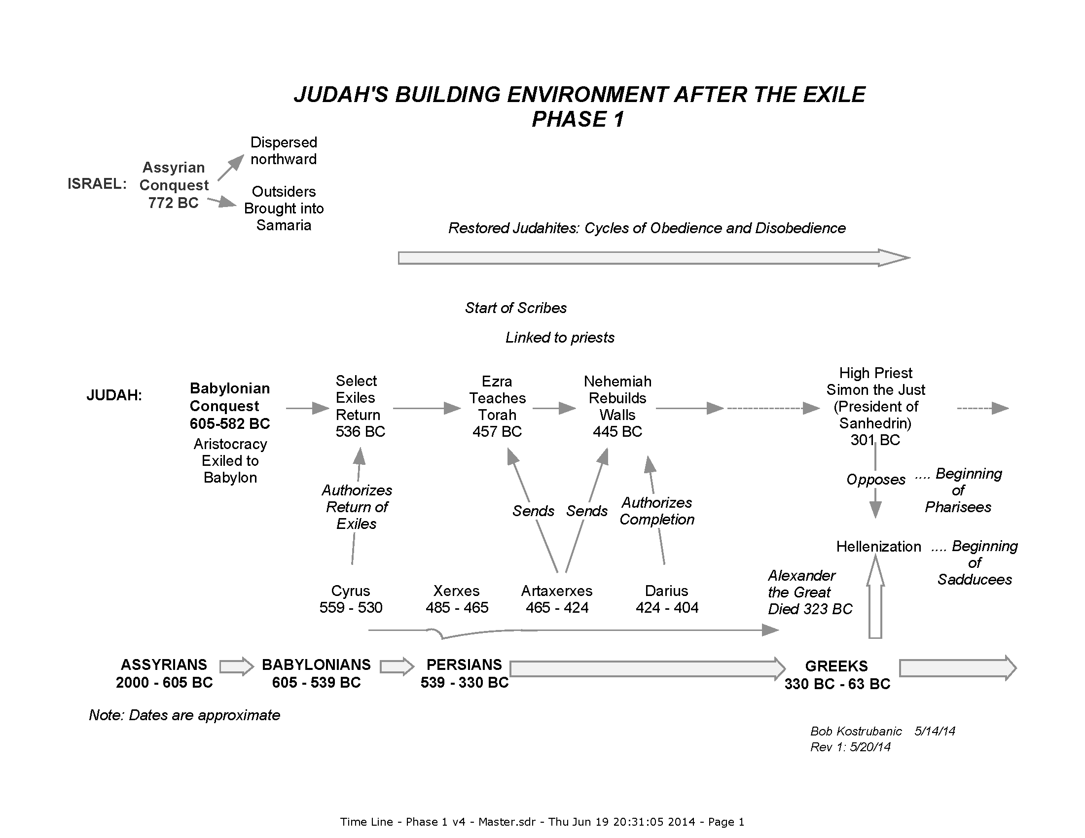

Slide 16
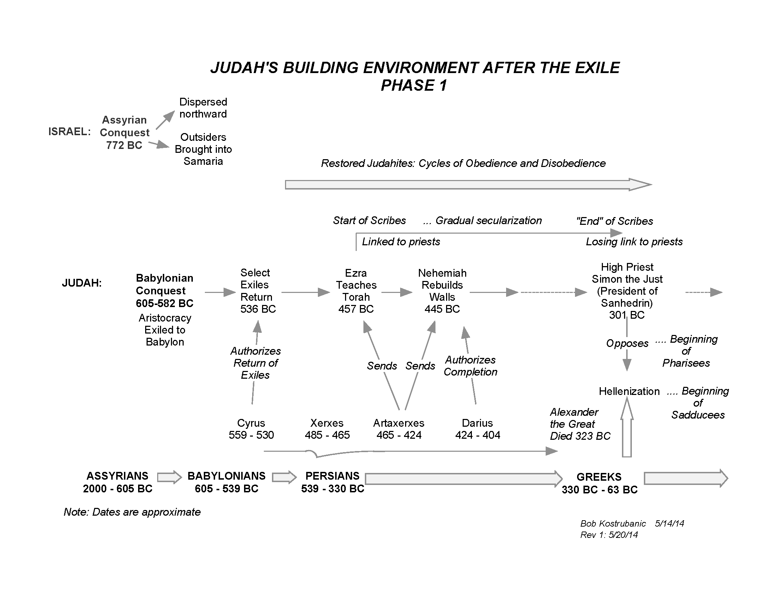

Slide 17
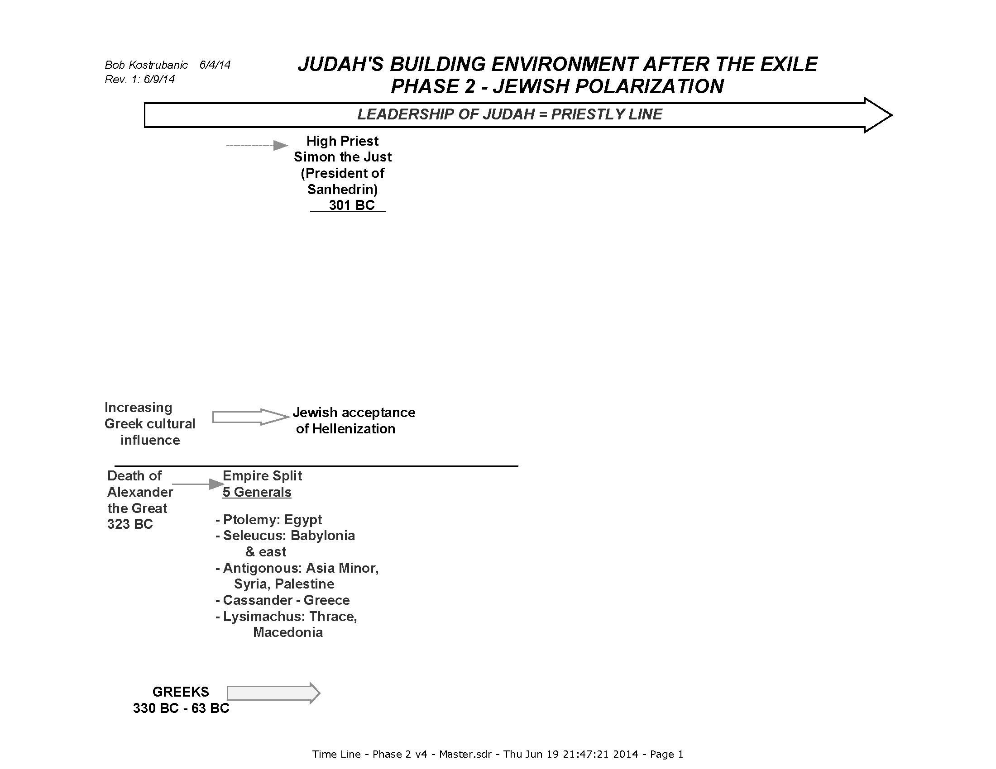

Slide 18
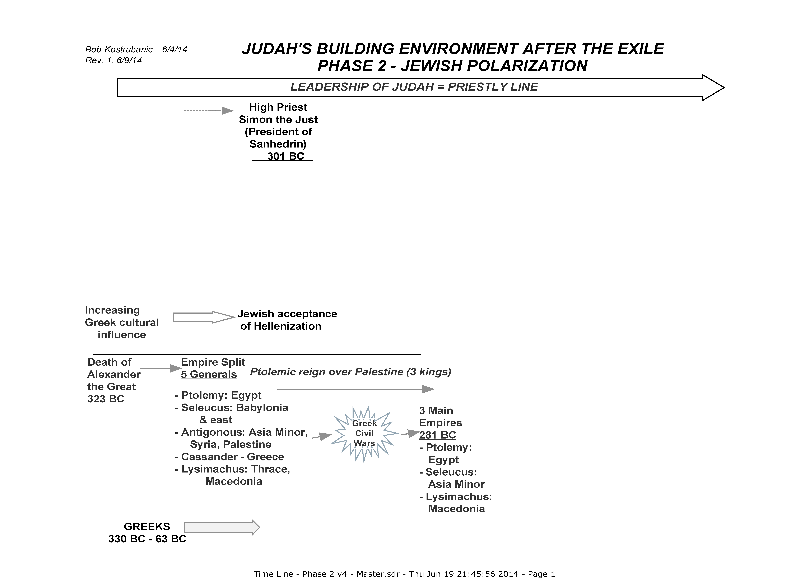

Slide 19
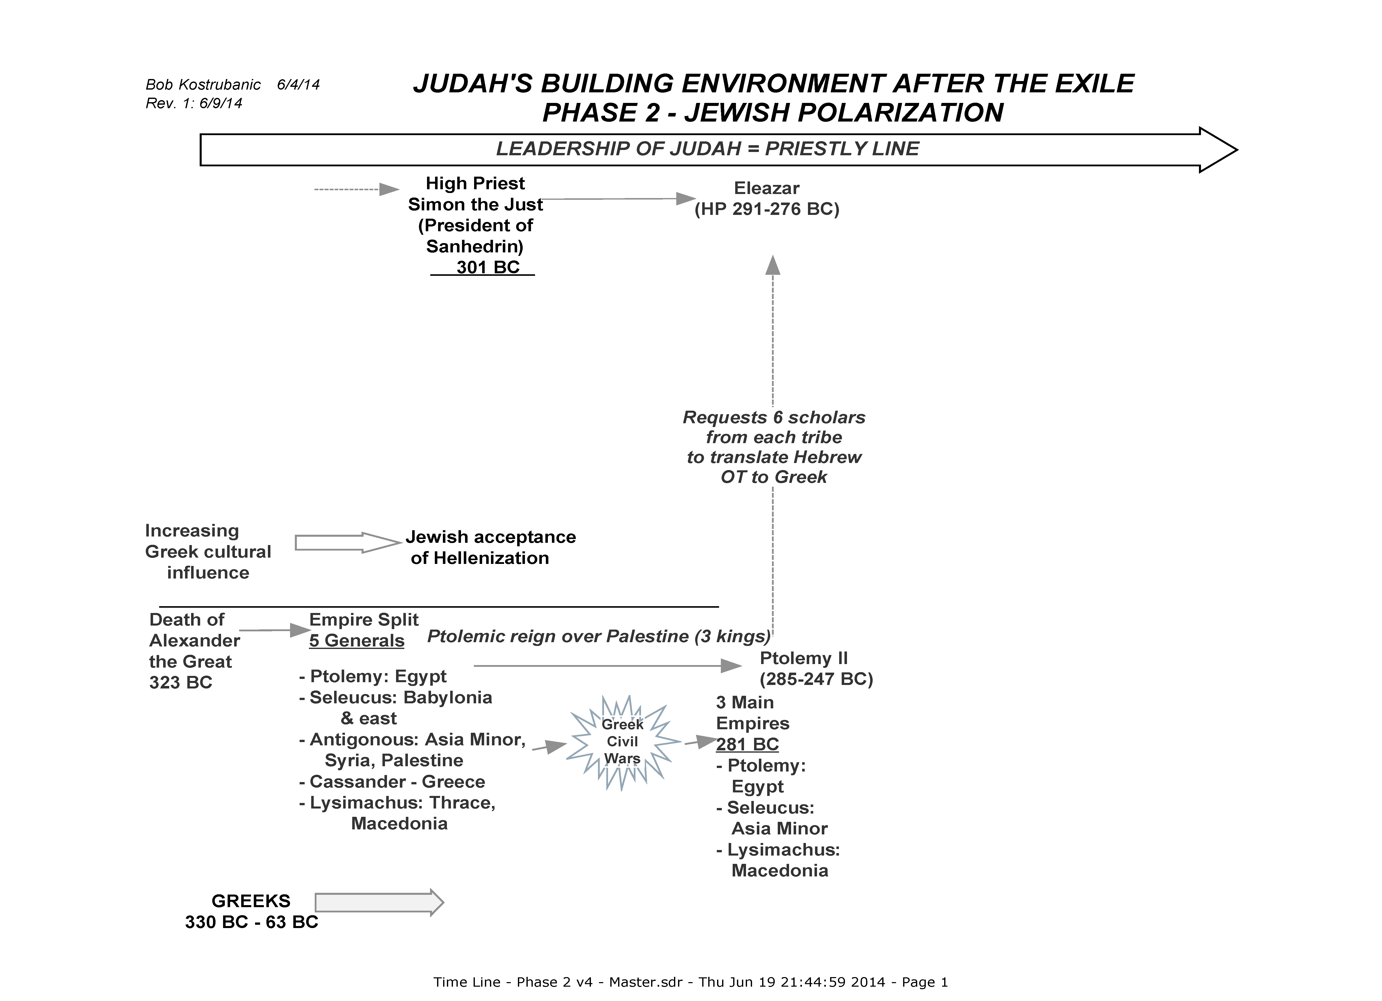

Slide 20
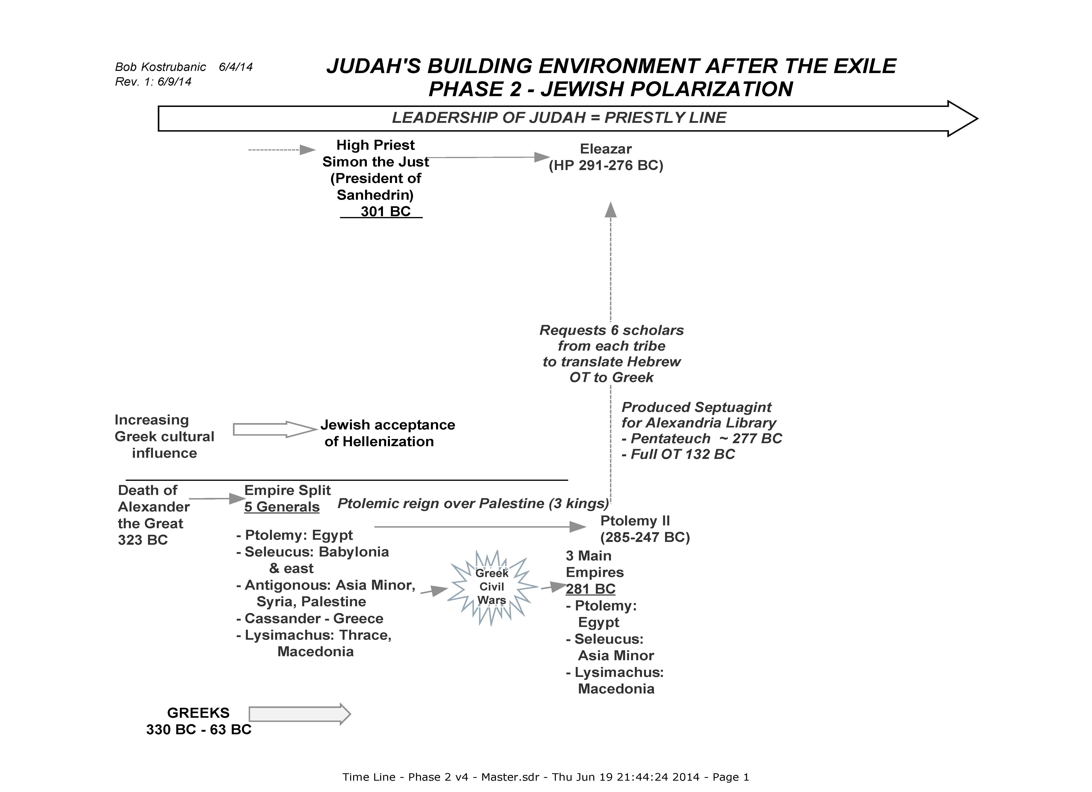

Slide 21
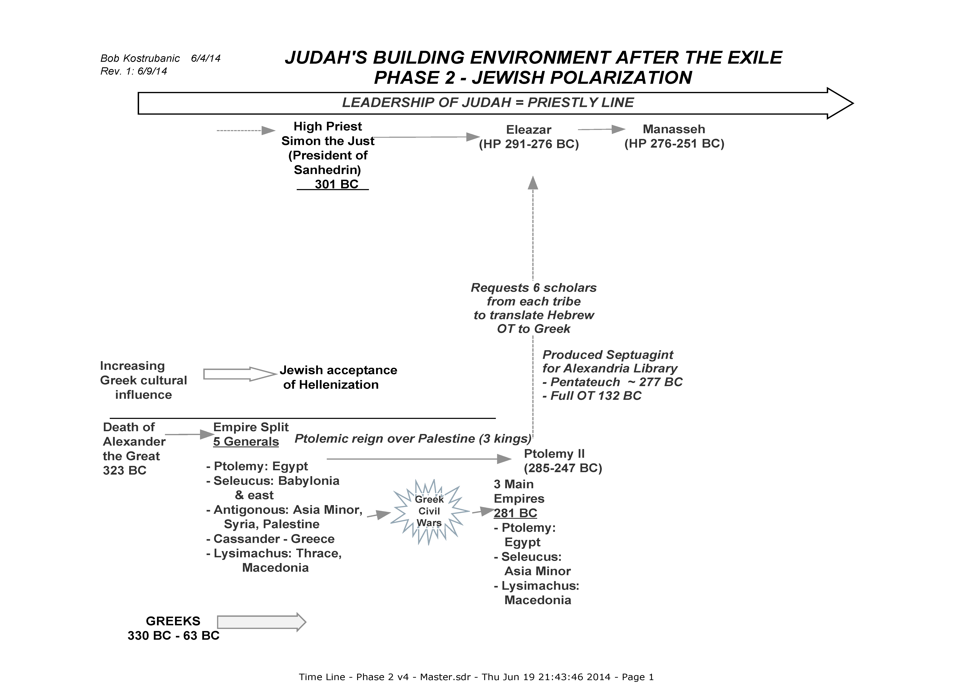

Slide 22
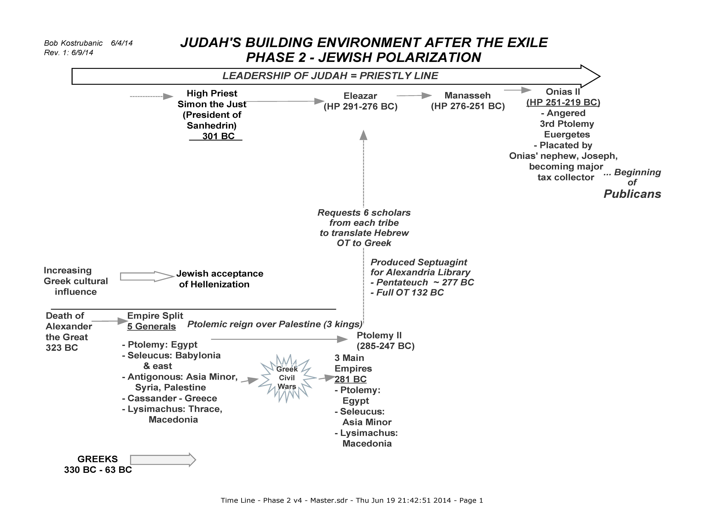

Slide 23
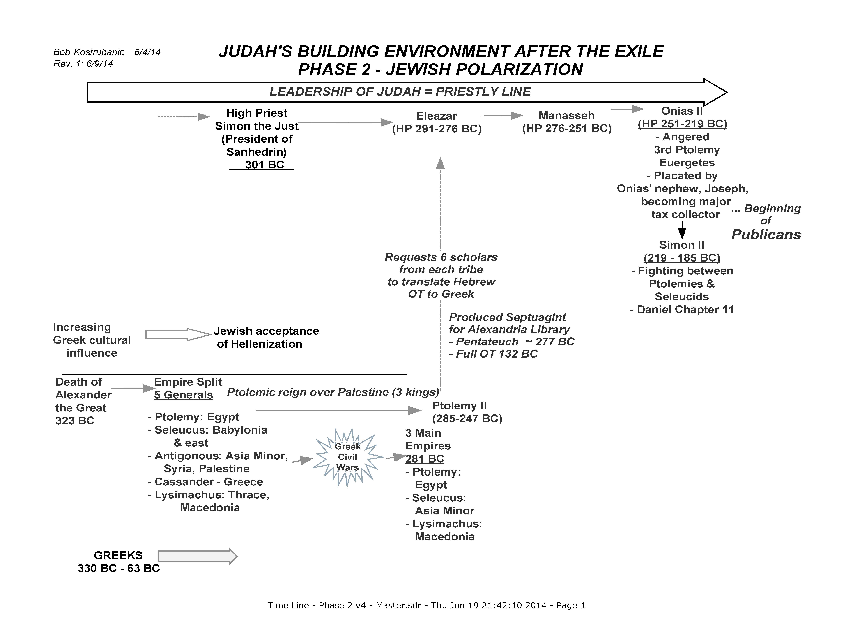

Slide 24
Decades of turmoil between Syria & Egypt
Daniel Chapter 11
5 “Then the king of the South will grow strong, along with one of his princes who will gain ascendancy over him and obtain dominion; his domain will be a great dominion indeed.
6 “After some years they will form an alliance, and the daughter of the king of the South will come to the king of the North to carry out a peaceful arrangement. But she will not retain her position of power, nor will he remain with his power, but she will be given up, along with those who brought her in and the one who sired her as well as he who supported her in those times.
7 “But one of the descendants of her line will arise in his place, and he will come against their army and enter the fortress of the king of the North, and he will deal with them and display great strength.
8 “Also their gods with their metal images and their precious vessels of silver and gold he will take into captivity to Egypt, and he on his part will refrain from attacking the king of the North for some years.
9 “Then the latter will enter the realm of the king of the South, but will return to his own land.
10 “His sons will mobilize and assemble a multitude of great forces; and one of them will keep on coming and overflow and pass through, that he may again wage war up to his very fortress.
Ptolemy I & Seleucus I
Fighting between the Ptolemies & Seleucides
Ptolemy Euergetes avenges death of his sister
Seleucide Antiochus III drives Egyptians to southern Judean border

Slide 25
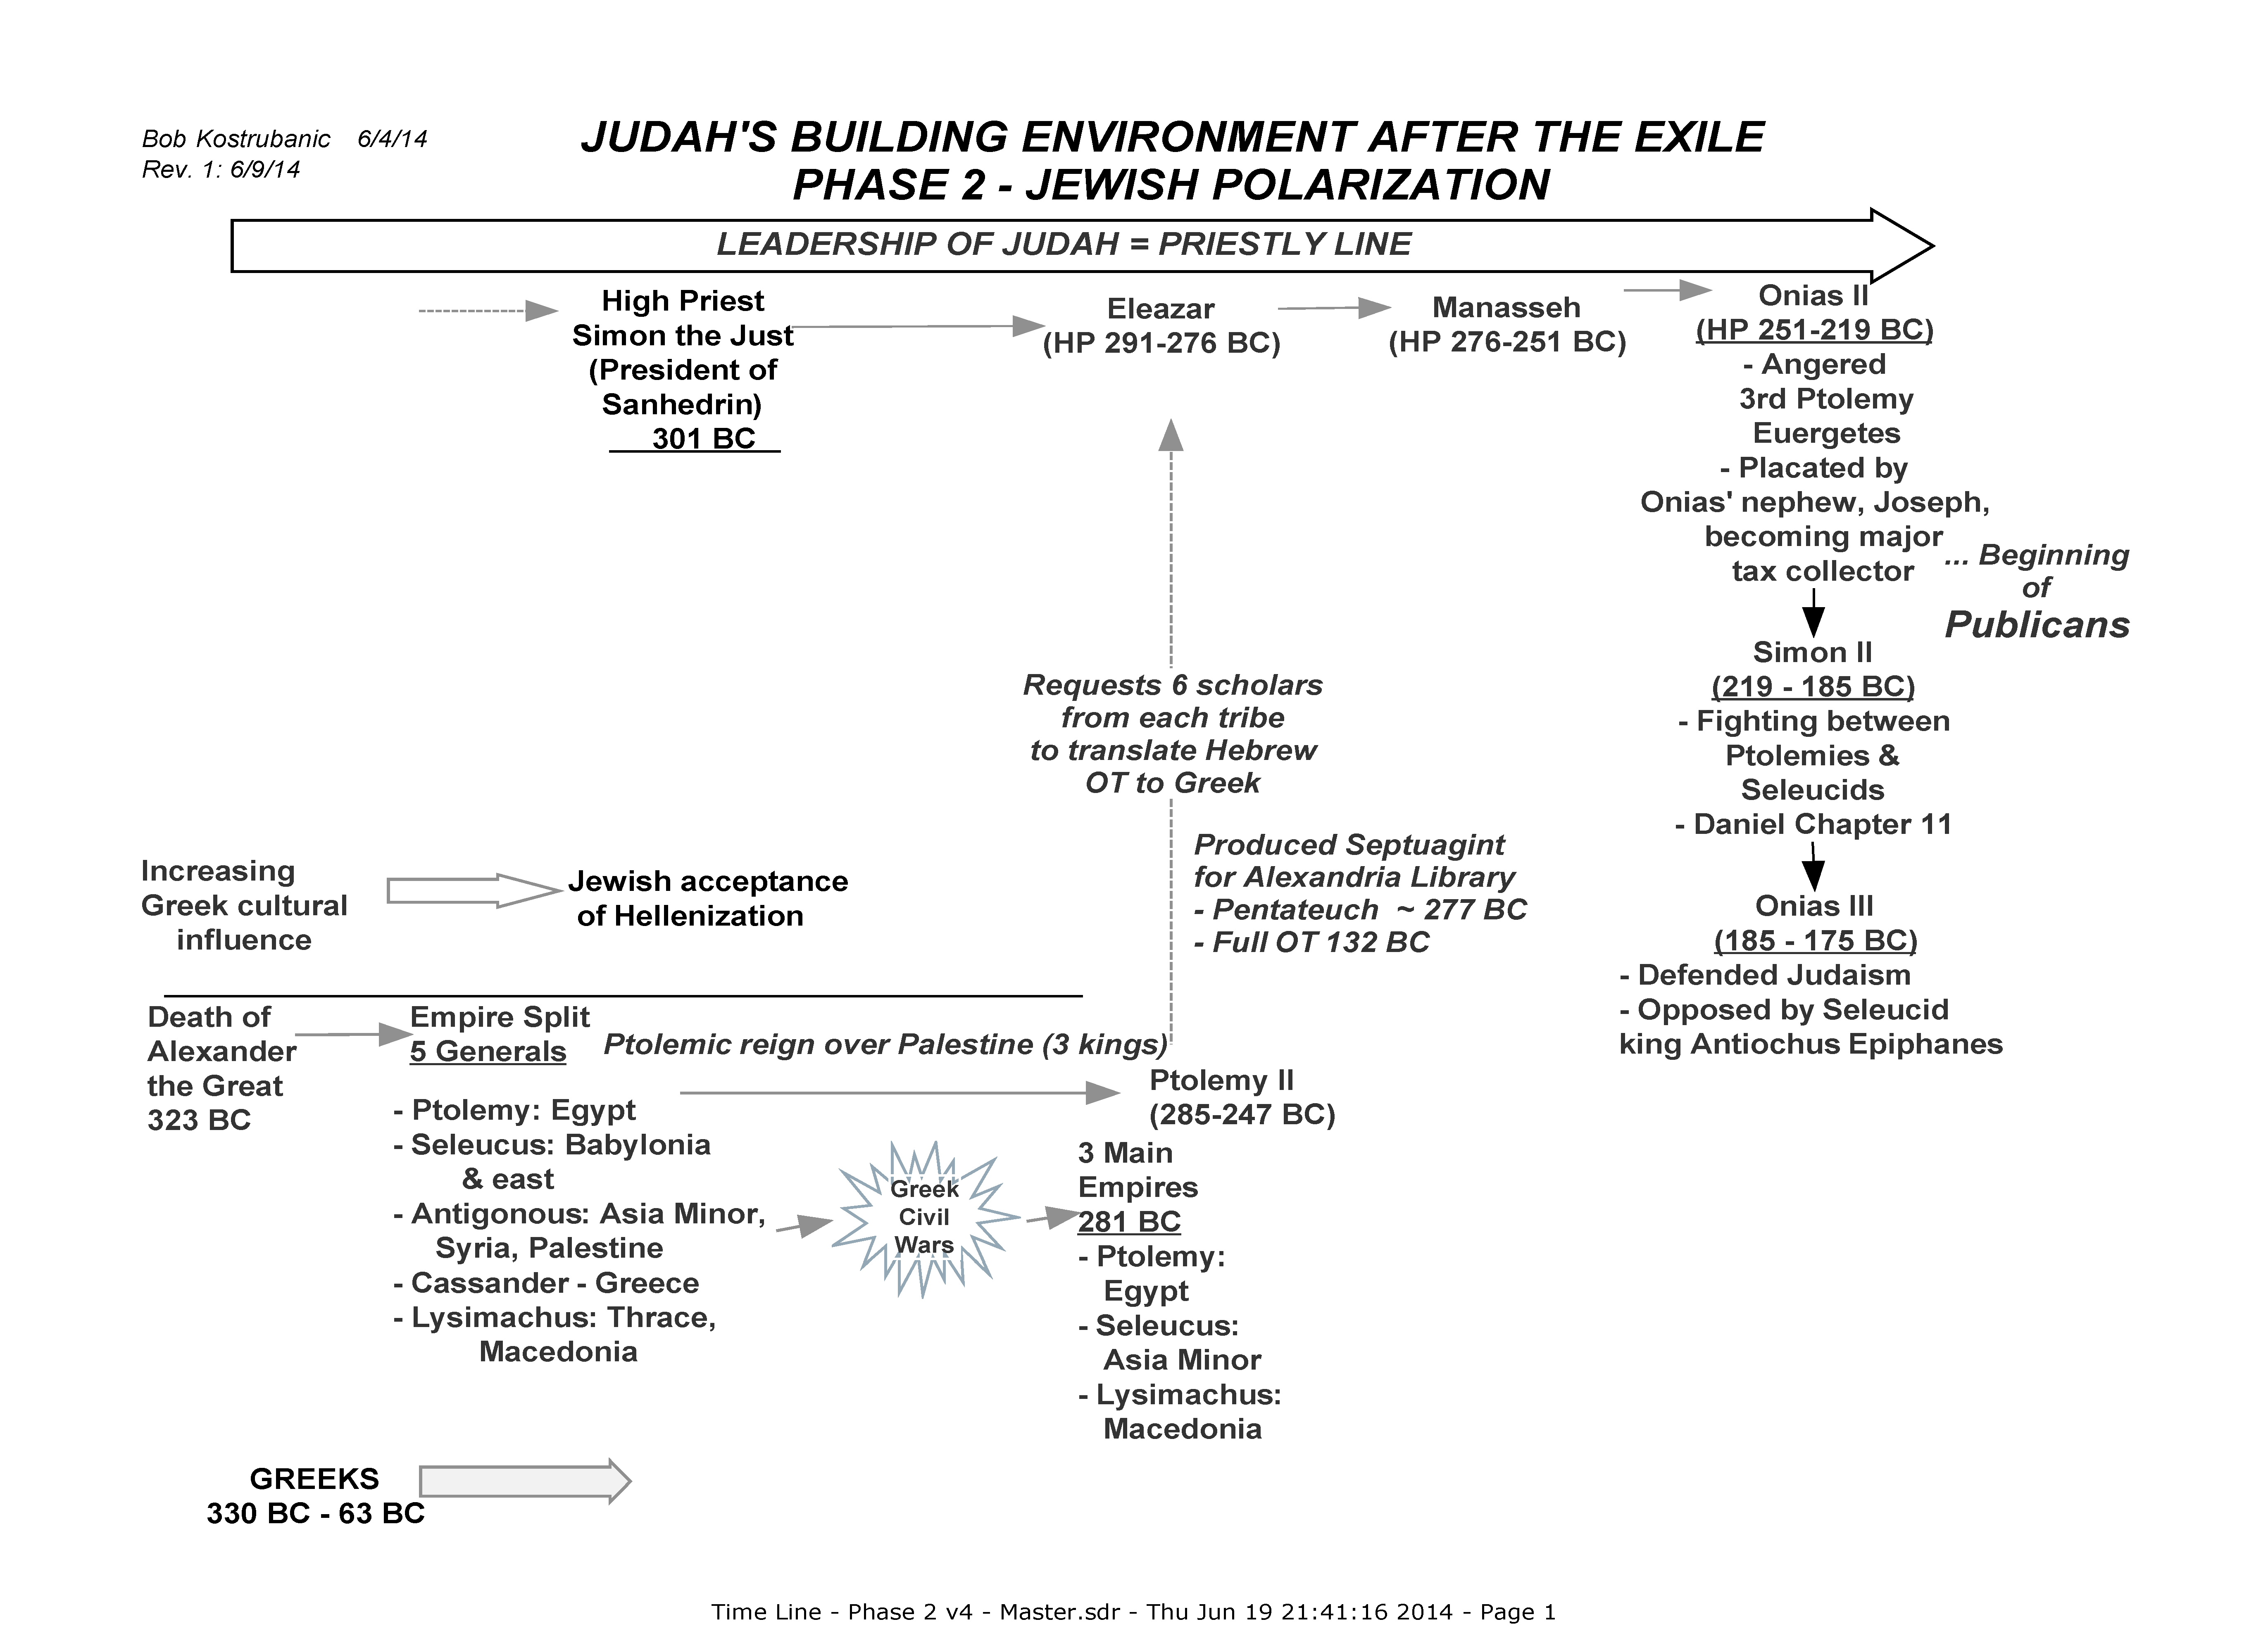

Slide 26
SITUATION SUMMARY: 323 – 167 BC
Judah now has had little history as a nation
Occupied by rulers & “neighbors”
Hellenizers (Sadducees & others) driving people away from Jewish religion
Priesthood as national leader trying to focus on Jewish religion, but vacillating toward politics
Polarization of the leadership
  Those following the high priest in observance of God’s ways
  Hellenizing Jews > independence from God’s ways, liberalization
Pharisees becoming more rigid & secluded, rather than spreading God’s Word

Slide 27
Political Parties in Judea 167 BC
Pharisees
  Learned positions
  Sought to influence by selected OT moralities
  Minority party
Hellenizers (Sadducees)
  Adopting Greek culture
  Pushing Israel to be a military kingdom
  Managed resources to control society
Essenes
  Priests from the common people, led by the “Teacher of Righteousness”
  Held to God’s Word, promise of the coming Messiah
Minor factions
  Egyptian party
  Syrian party

Slide 28


Slide 29
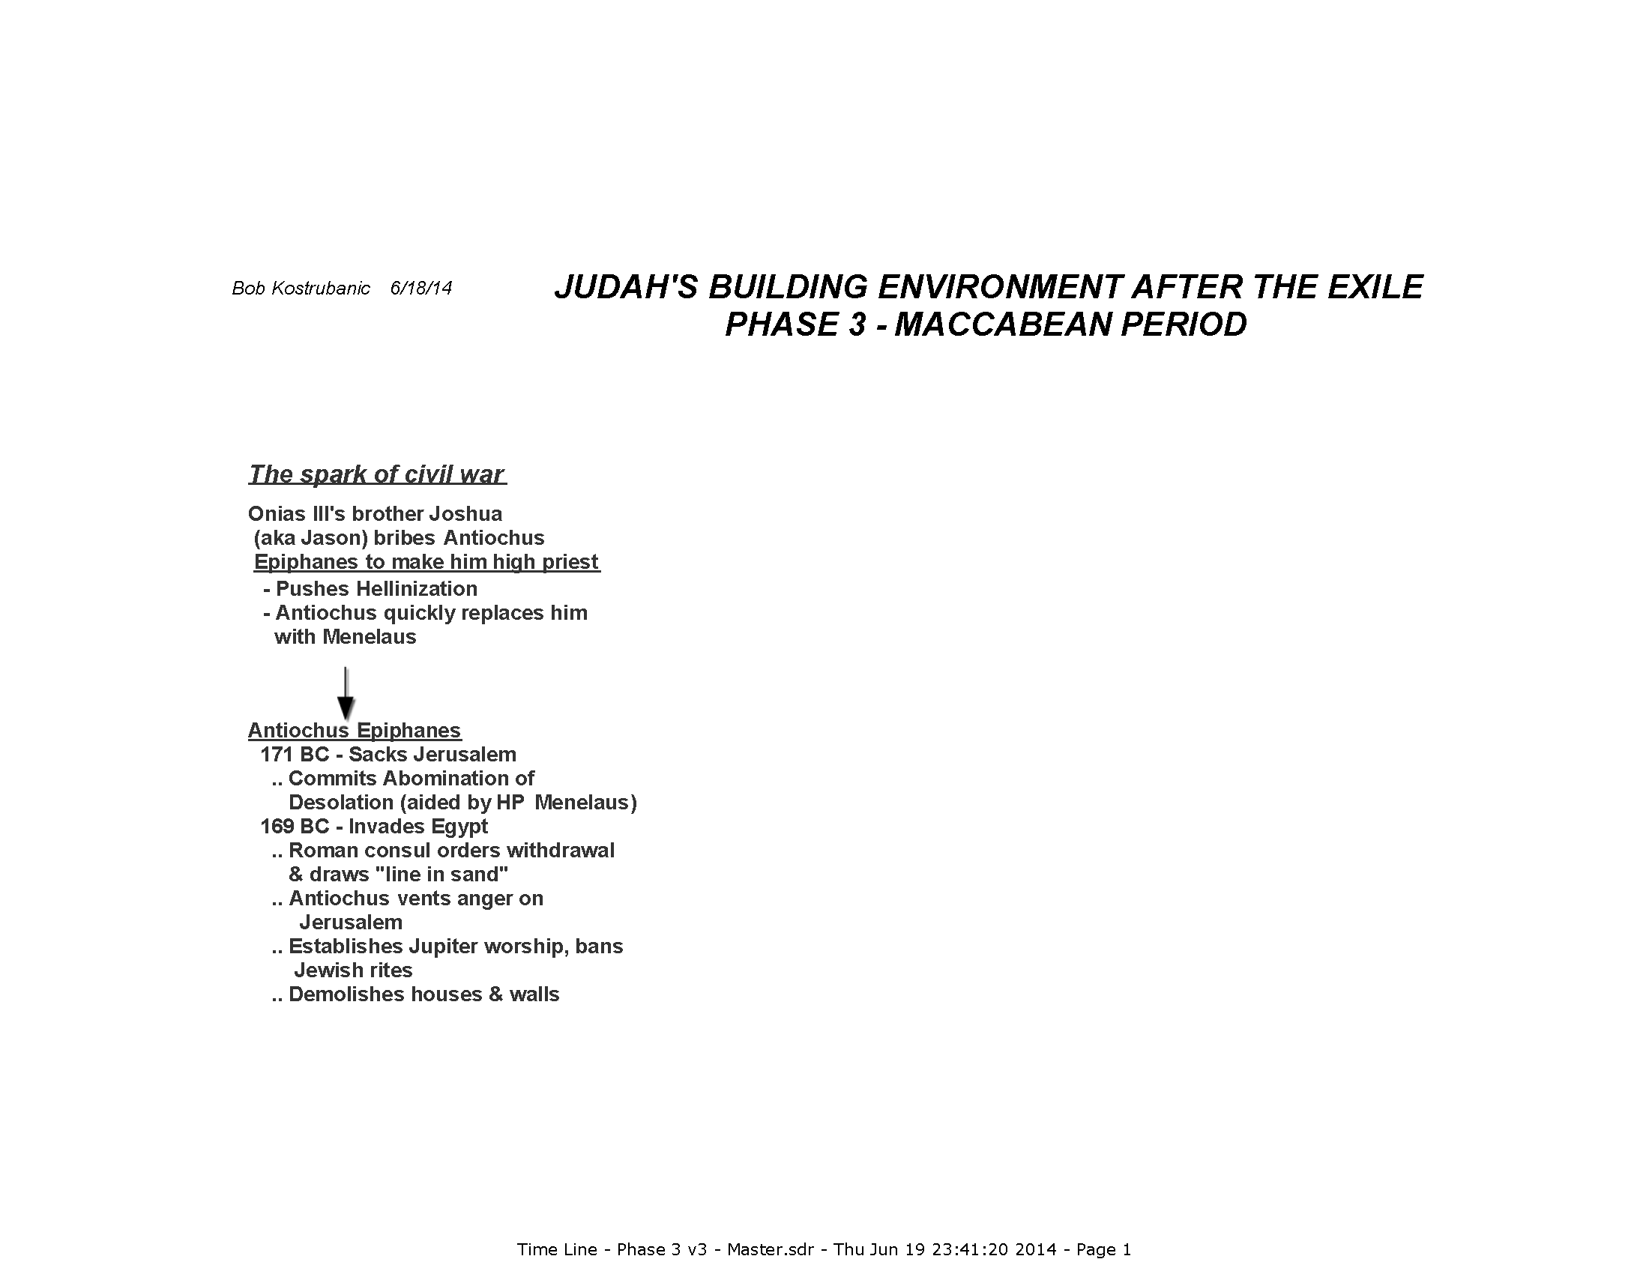

Slide 30
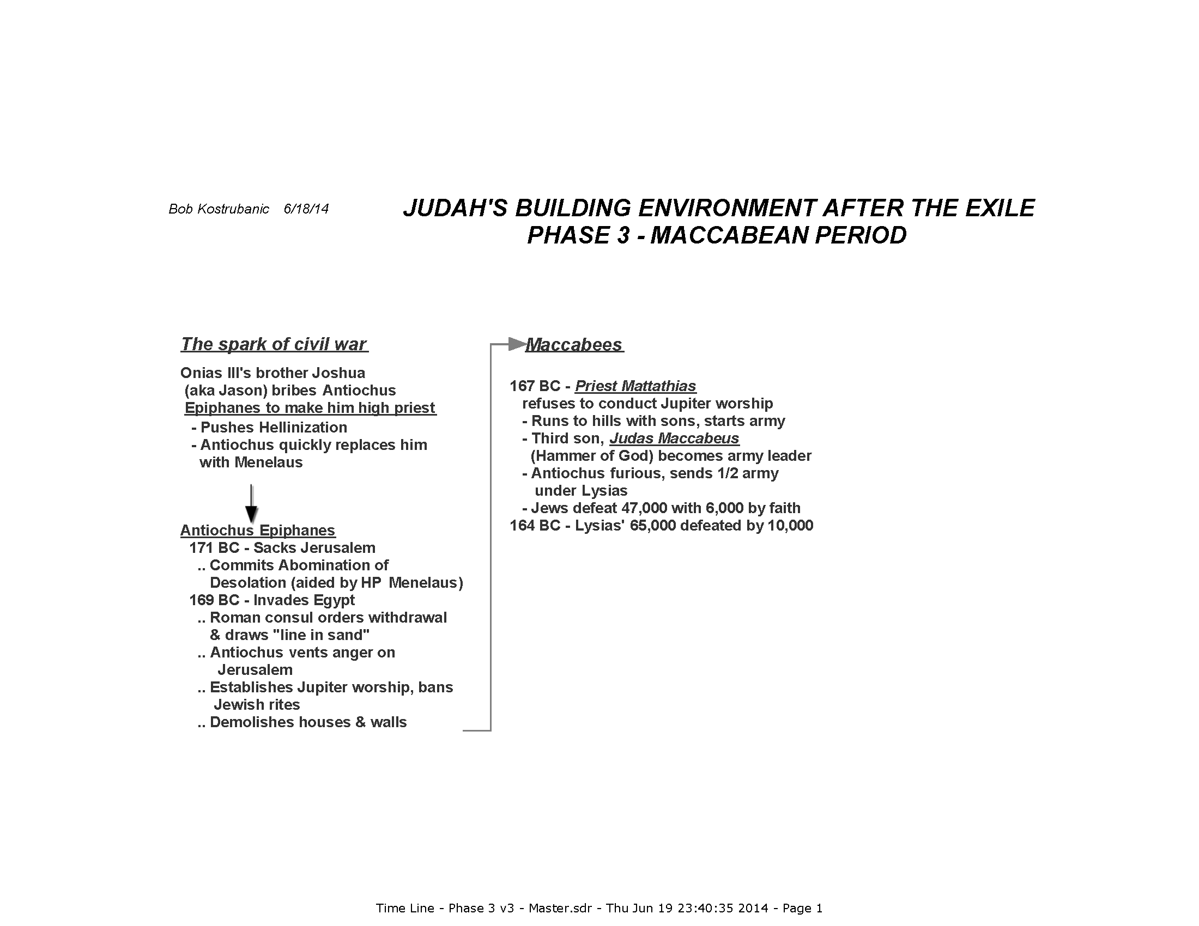

Slide 31
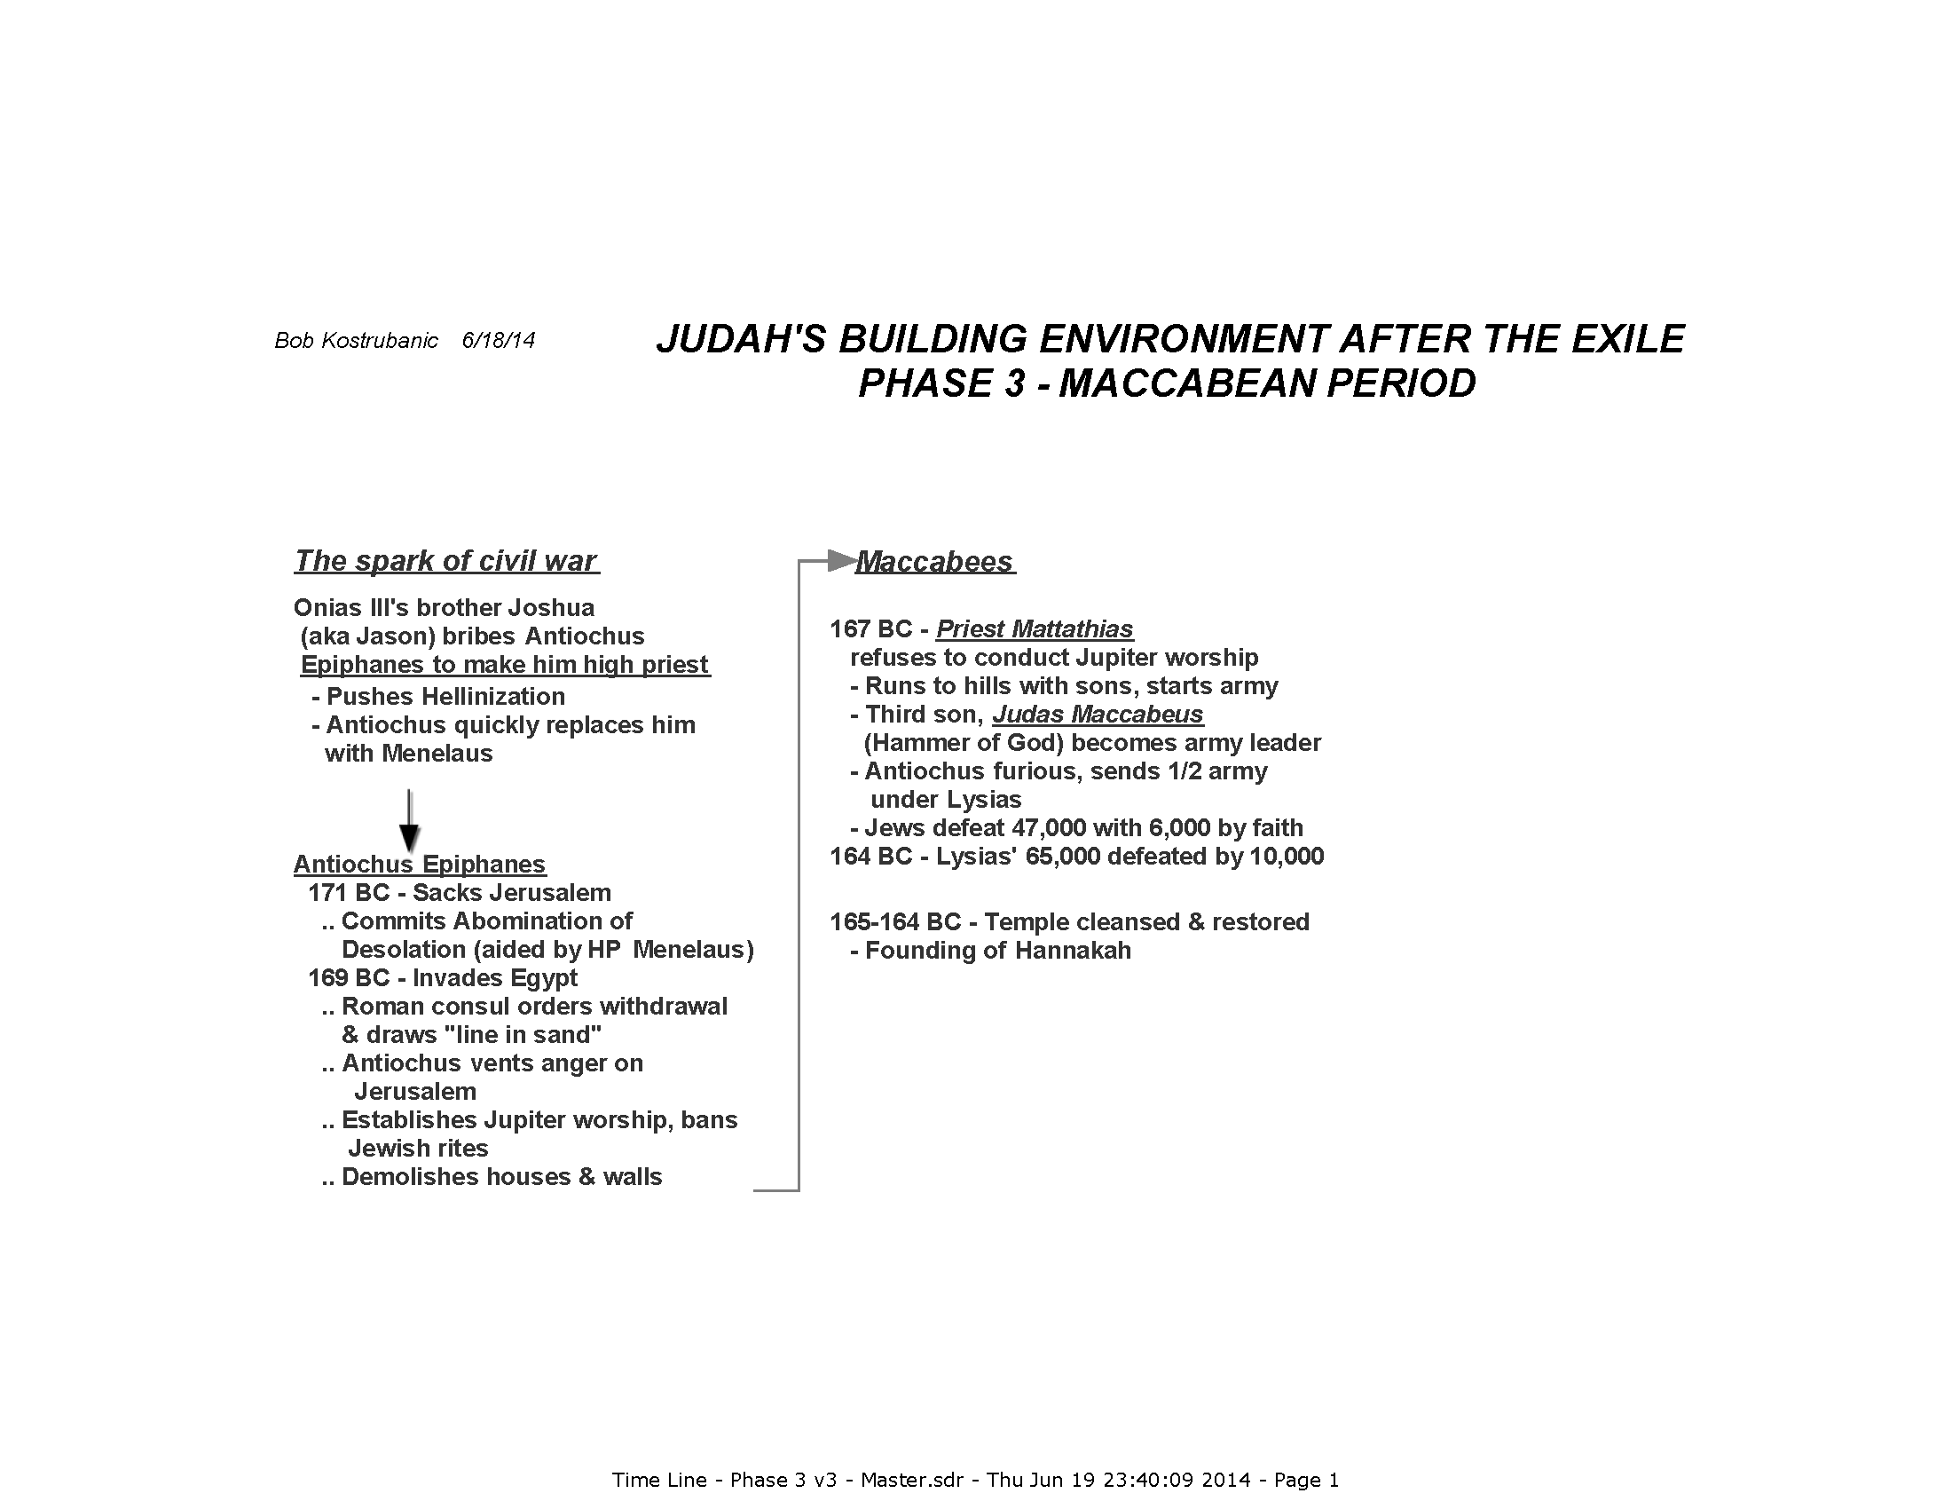

Slide 32
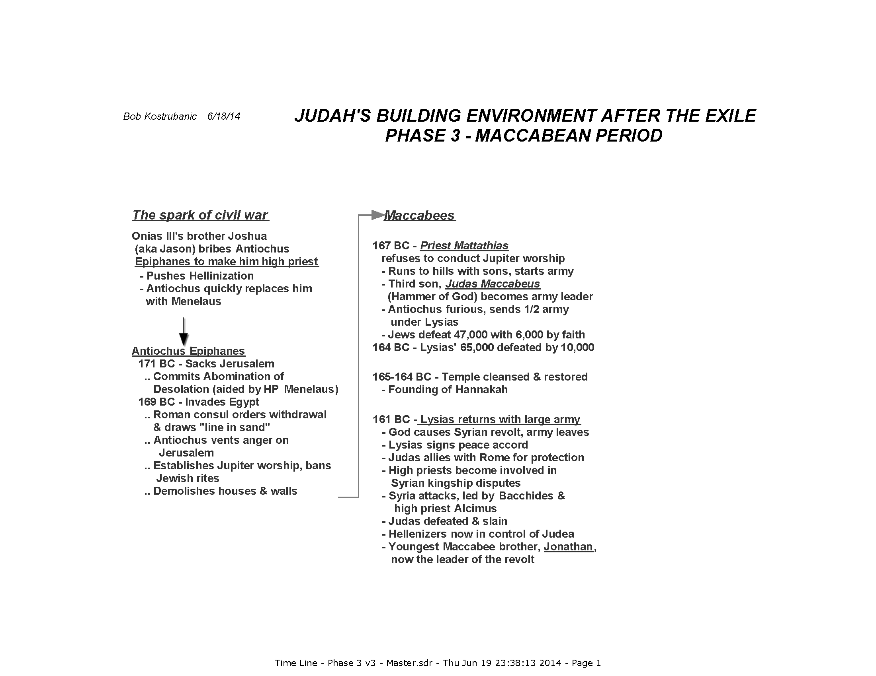

Slide 33
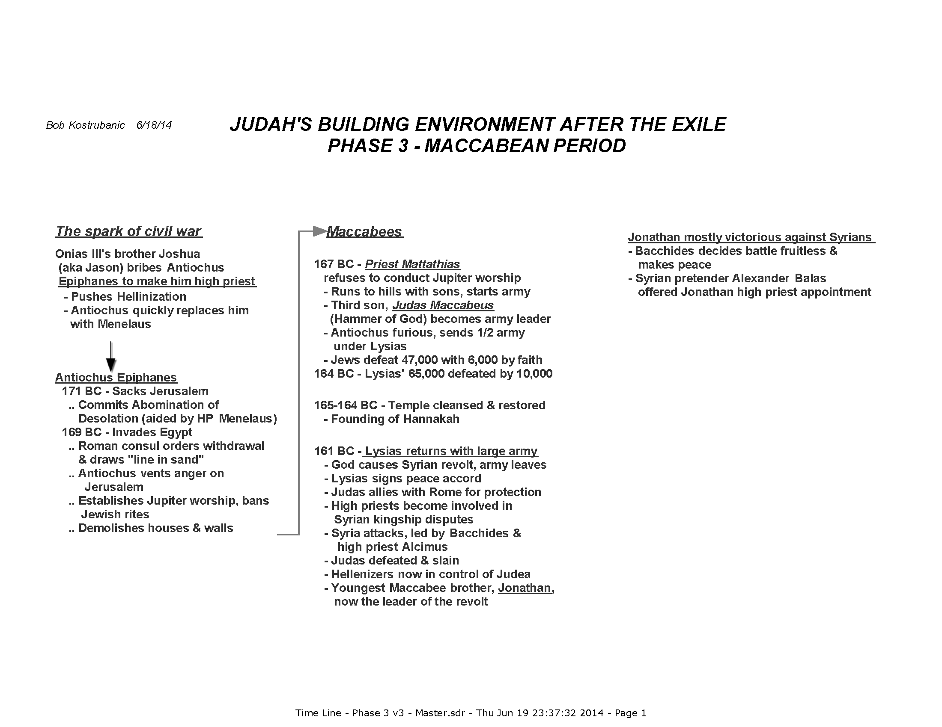

Slide 35
At this point in Judea …
Pretender Alexander Balas convinced Rome he was the legitimate son of Antiochus Epiphanes … is declared King Alexander
Region’s leadership is now …
  A Maccabean is high priest – Jonathan
  A Roman puppet is on the Syrian throne – Alexander Balas
  There is a Roman-Jewish alliance in force
  The Syrian foreign party was crushed
Perfect for the Jews, no ?
  It was man’s work – God was not consulted !

Slide 36
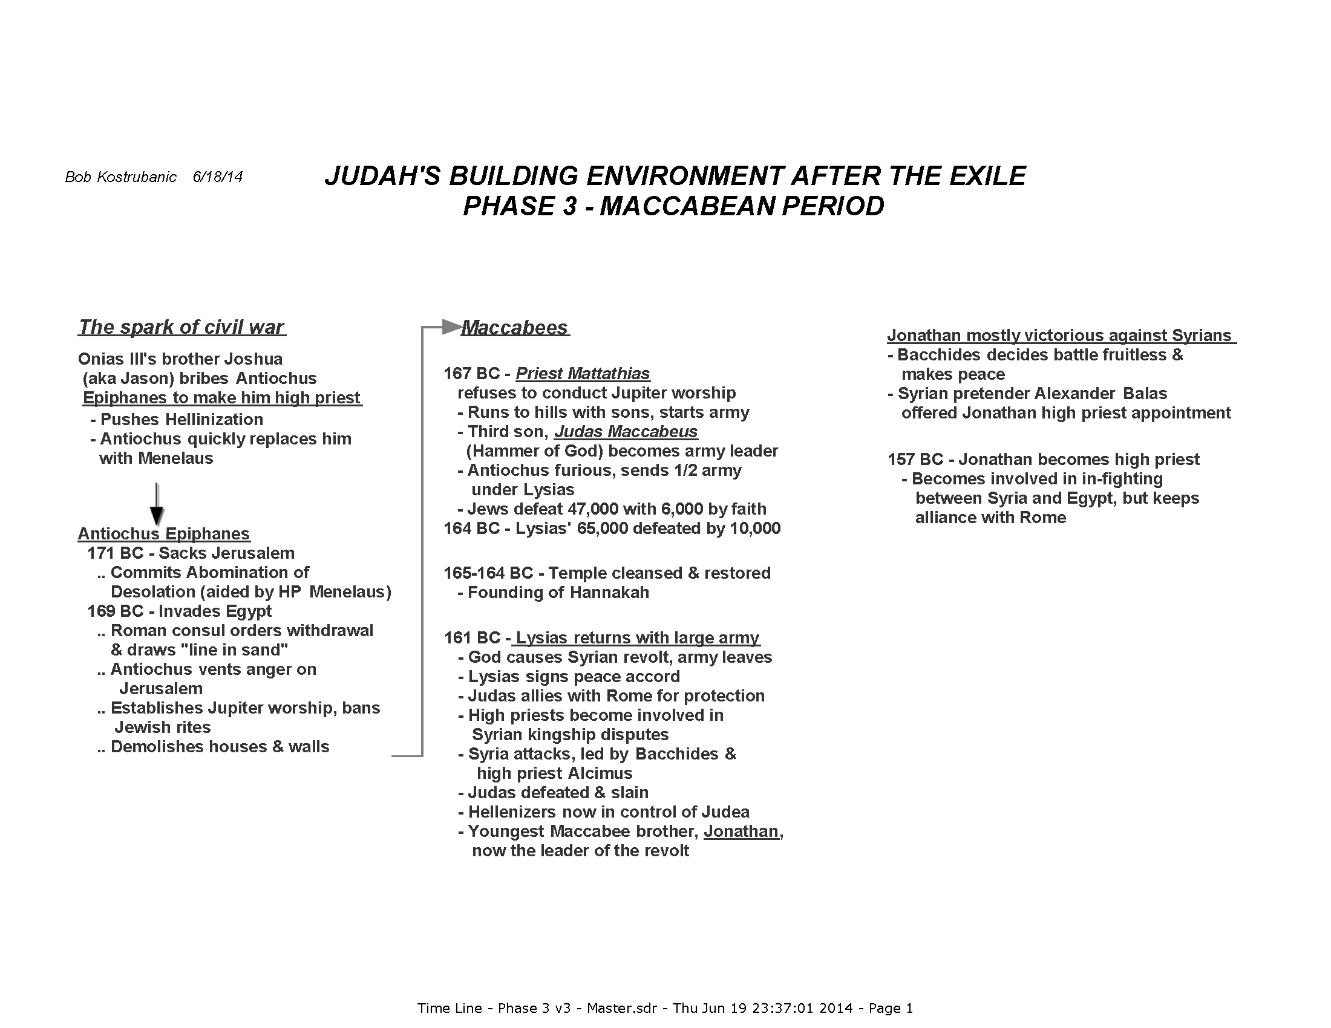

Slide 37
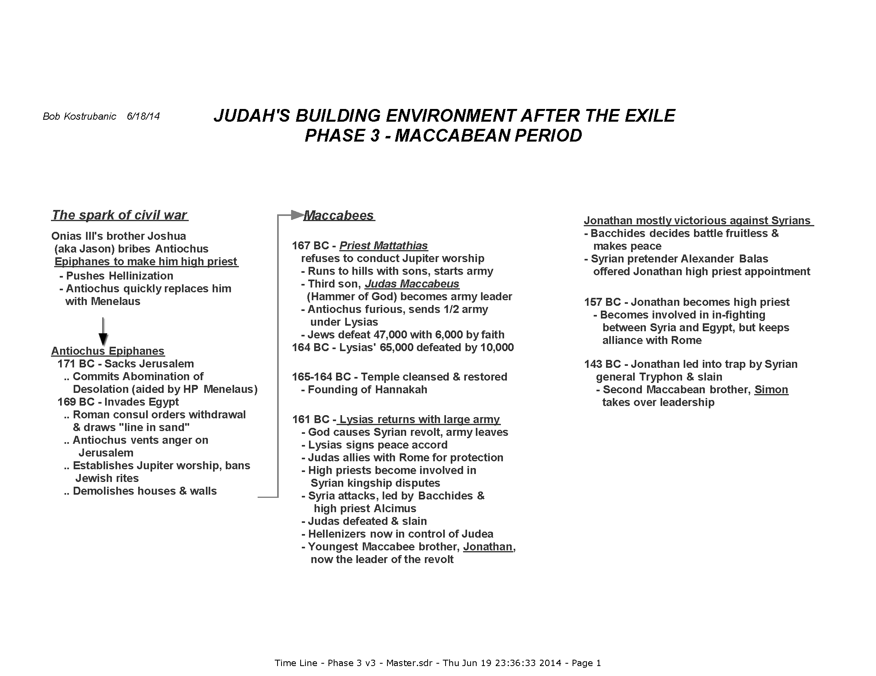

Slide 38
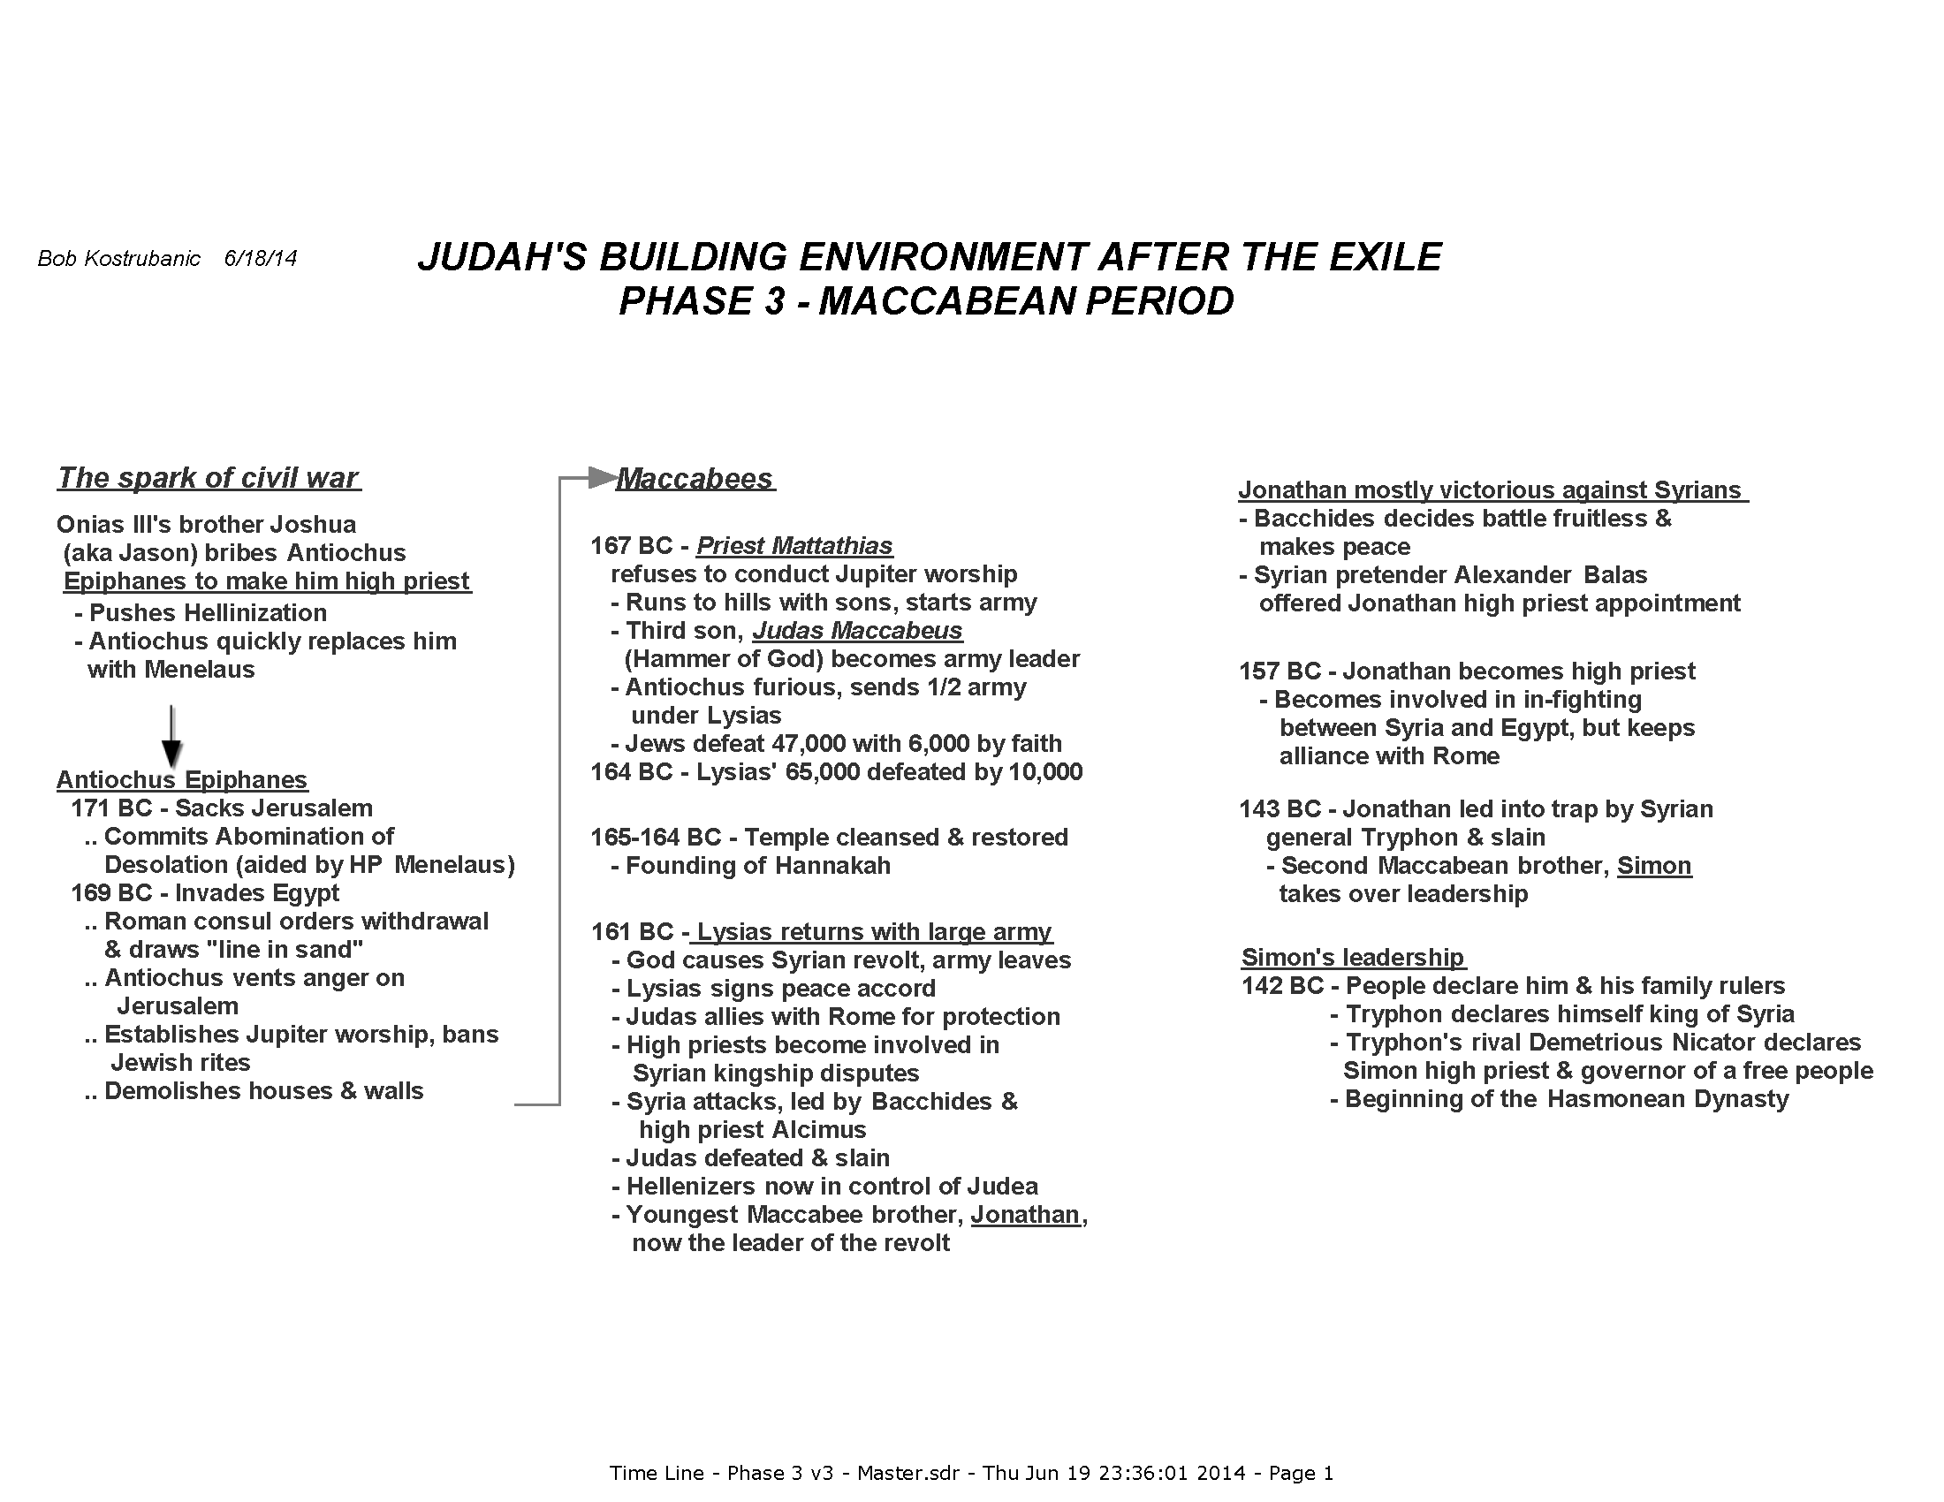

Slide 39
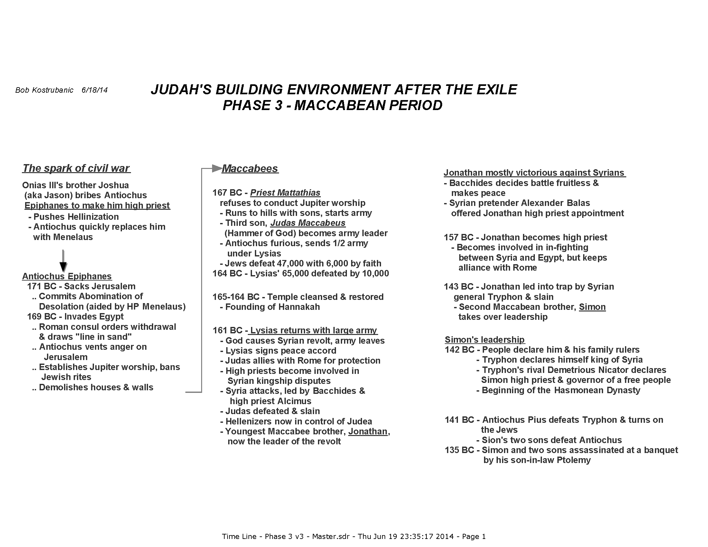

Slide 40
Key lessons NOT learned by the Jews
Leadership drifted from the priest-led sole dependence on God (the reason for earlier Maccabean victories) to political alliances
Without spiritual leadership and moral guidance, the people drifted more toward Hellenization for personal safety and comfort

Slide 41


Slide 42
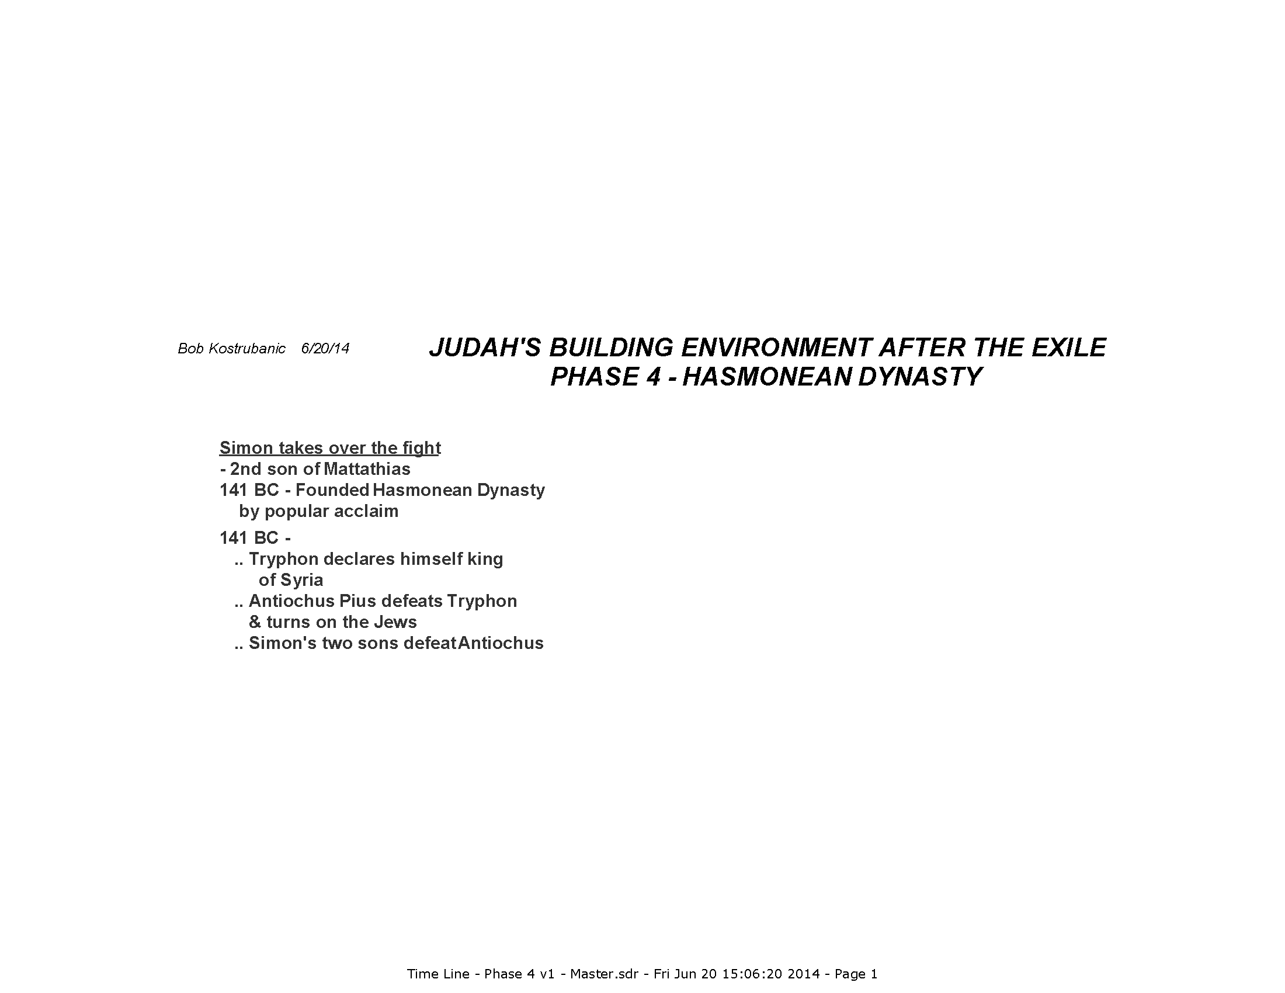

Slide 43
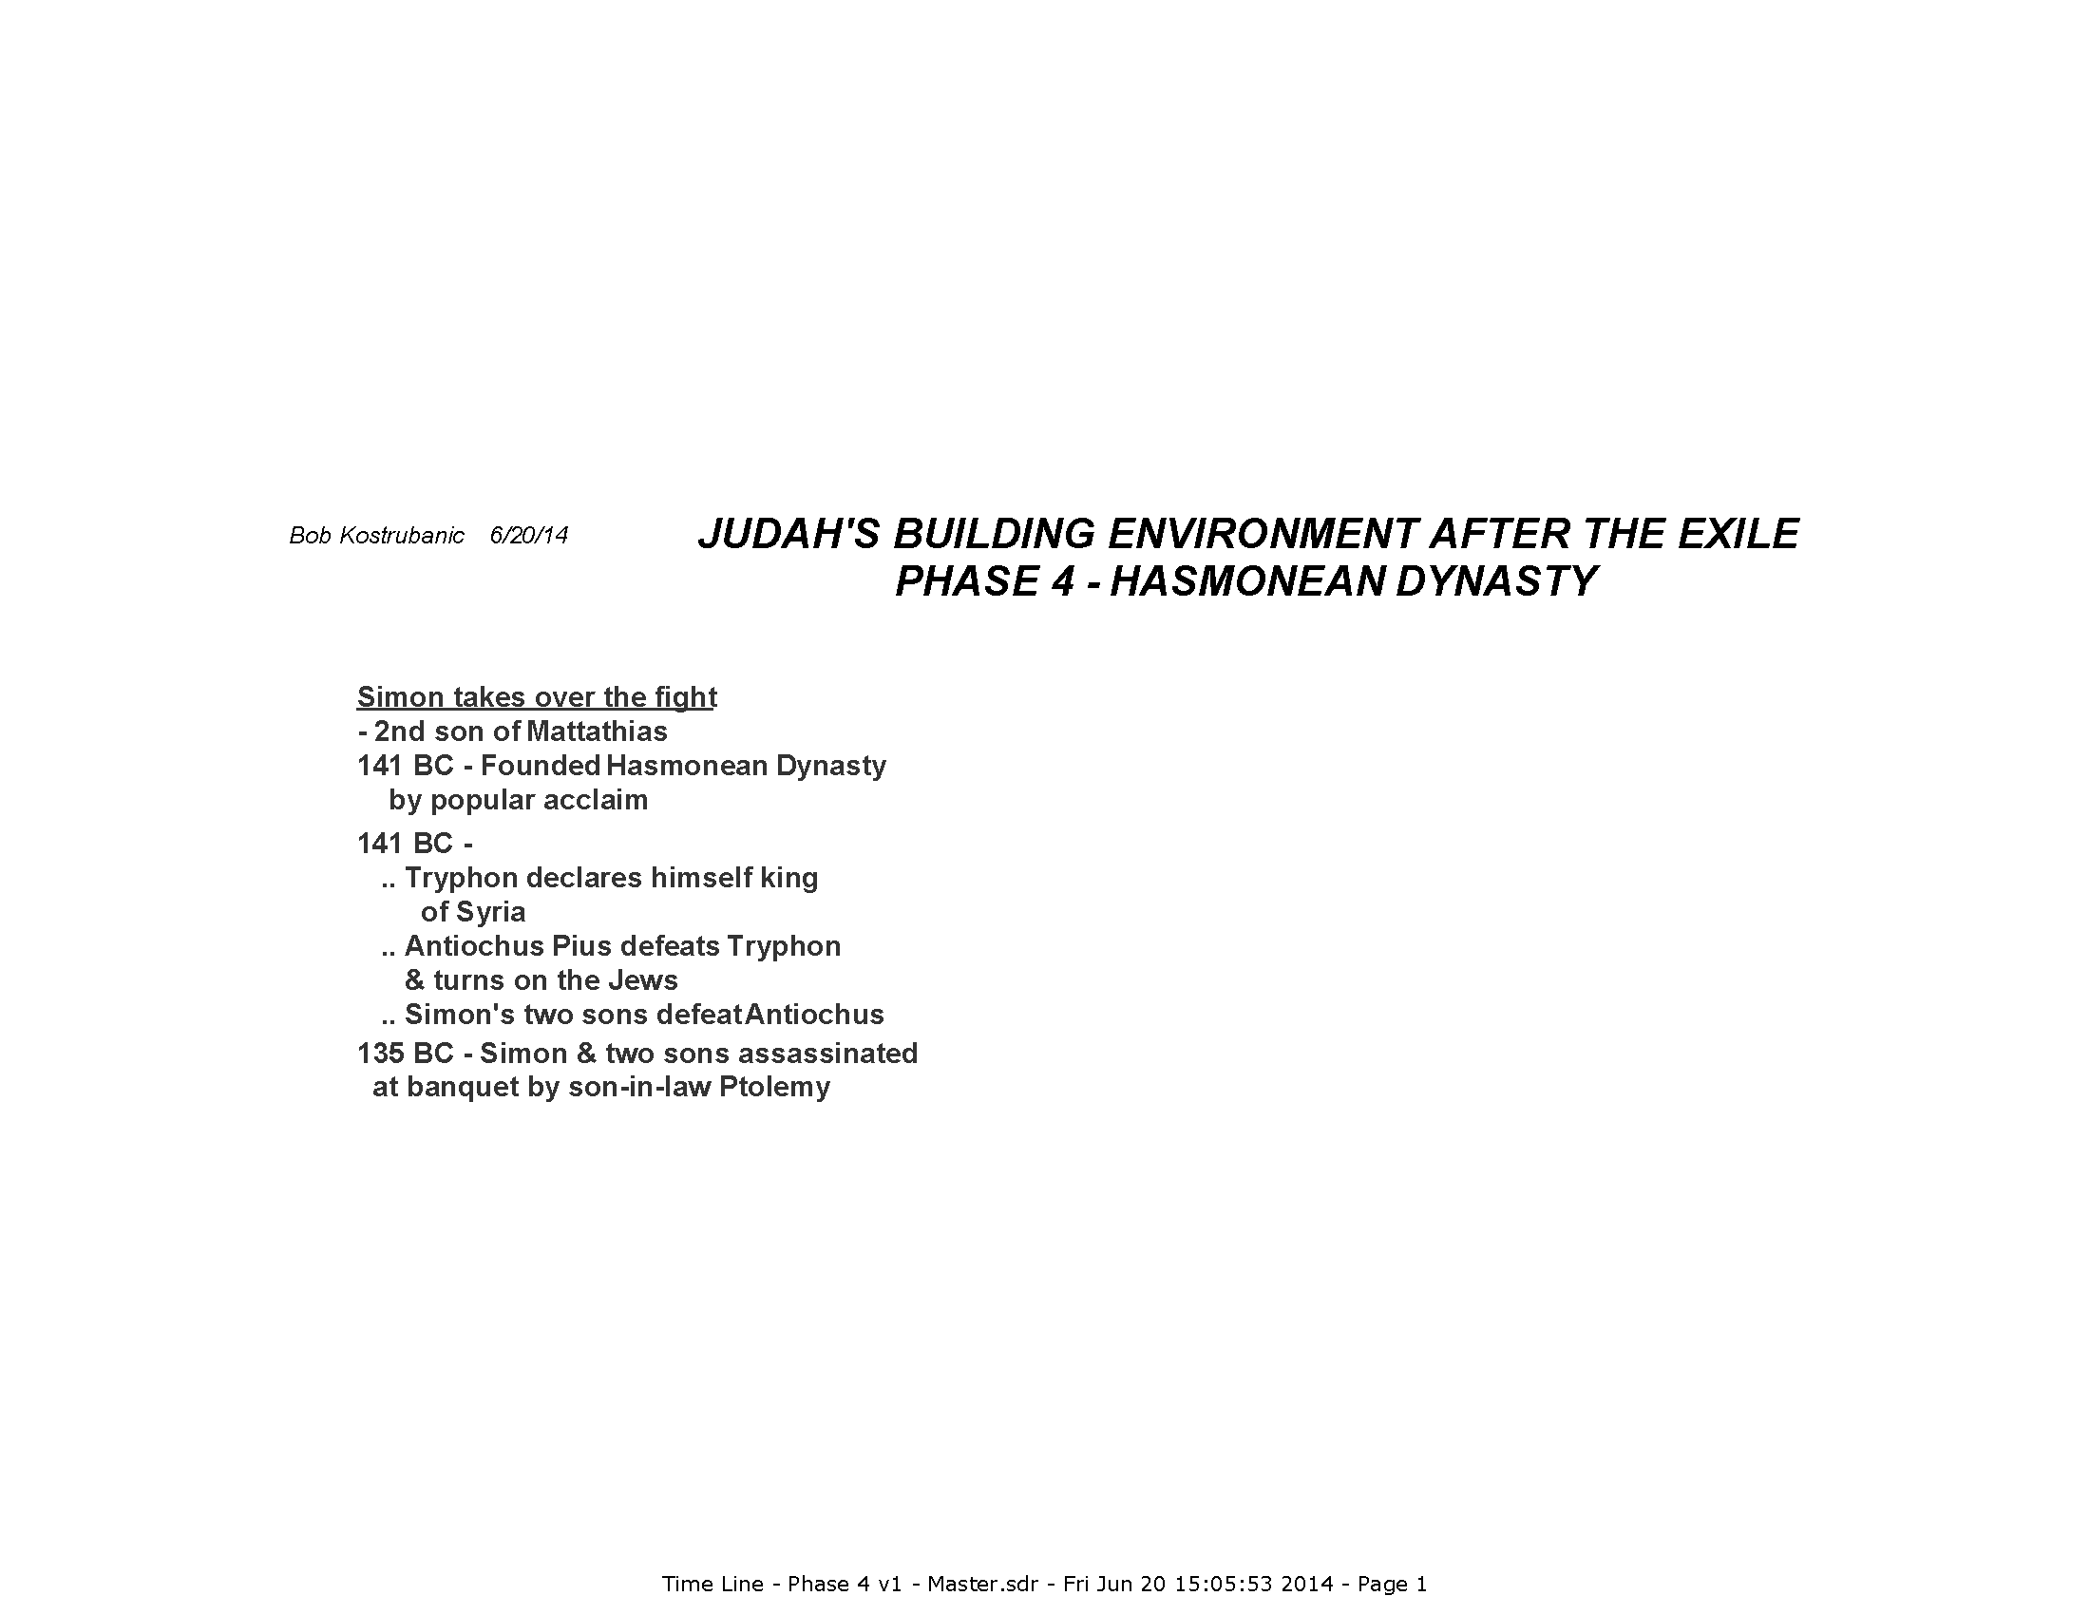

Slide 44
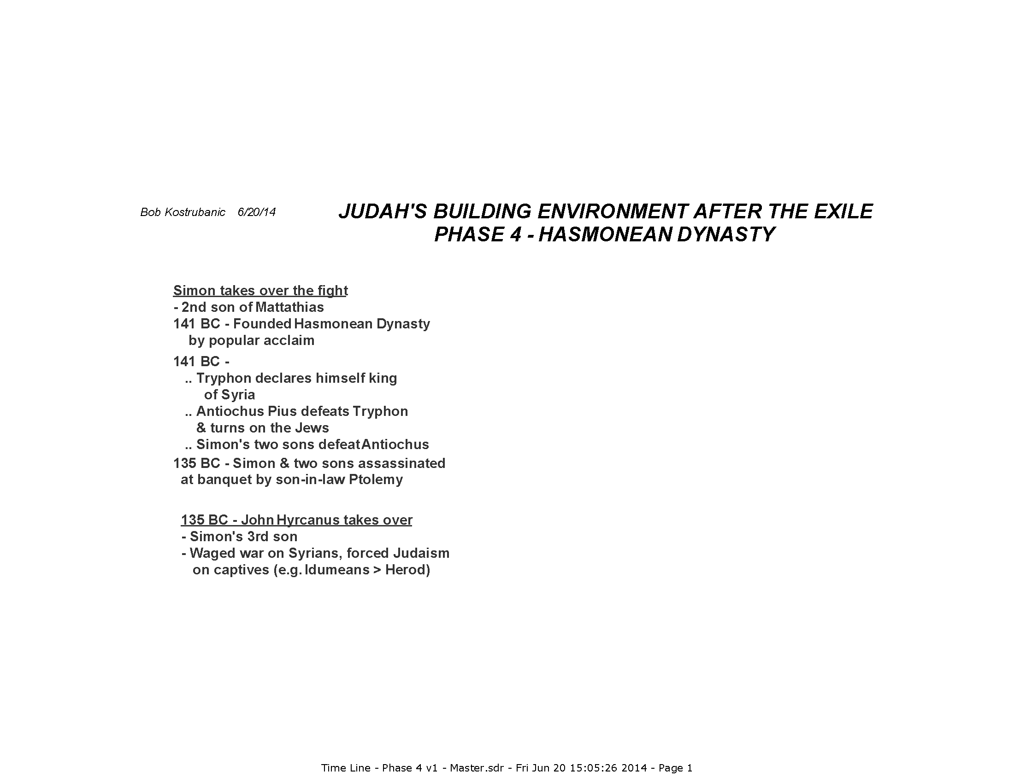

Slide 45
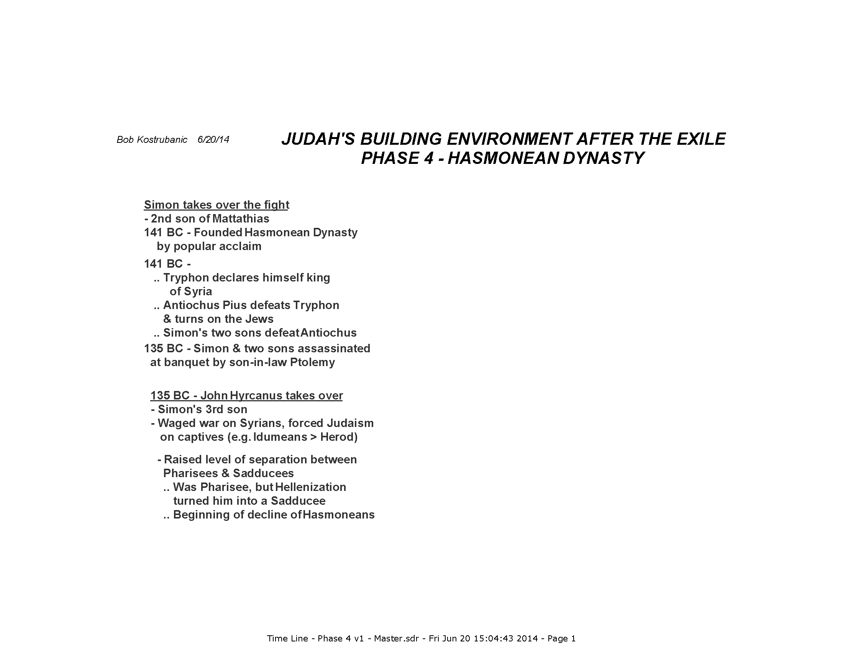

Slide 46
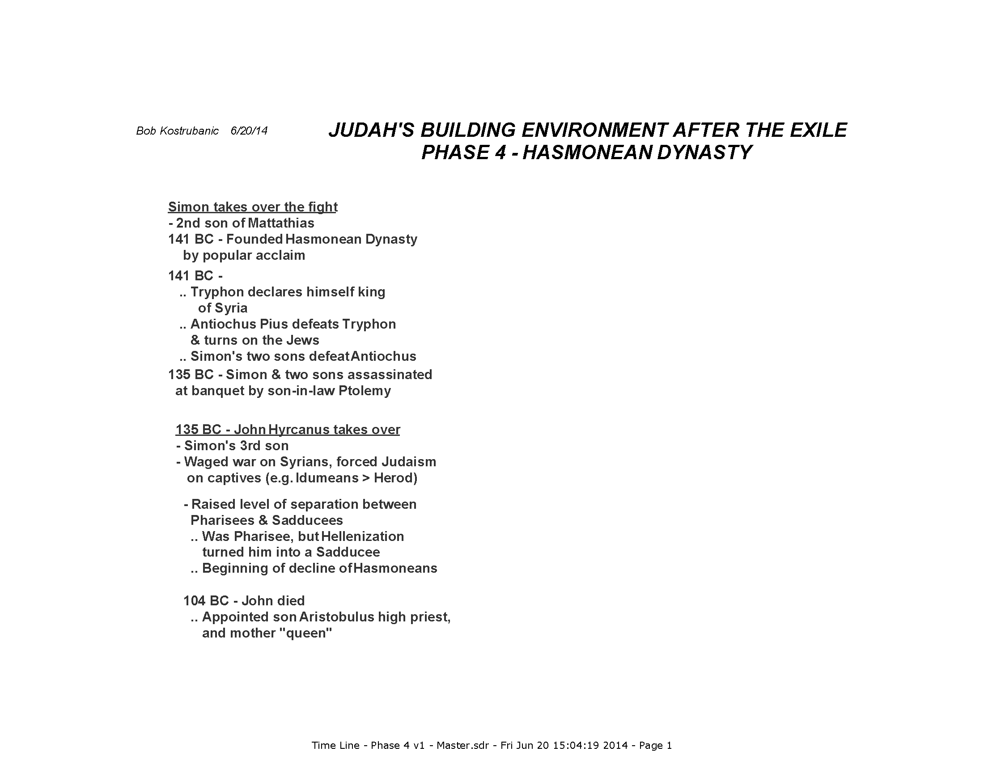

Slide 47
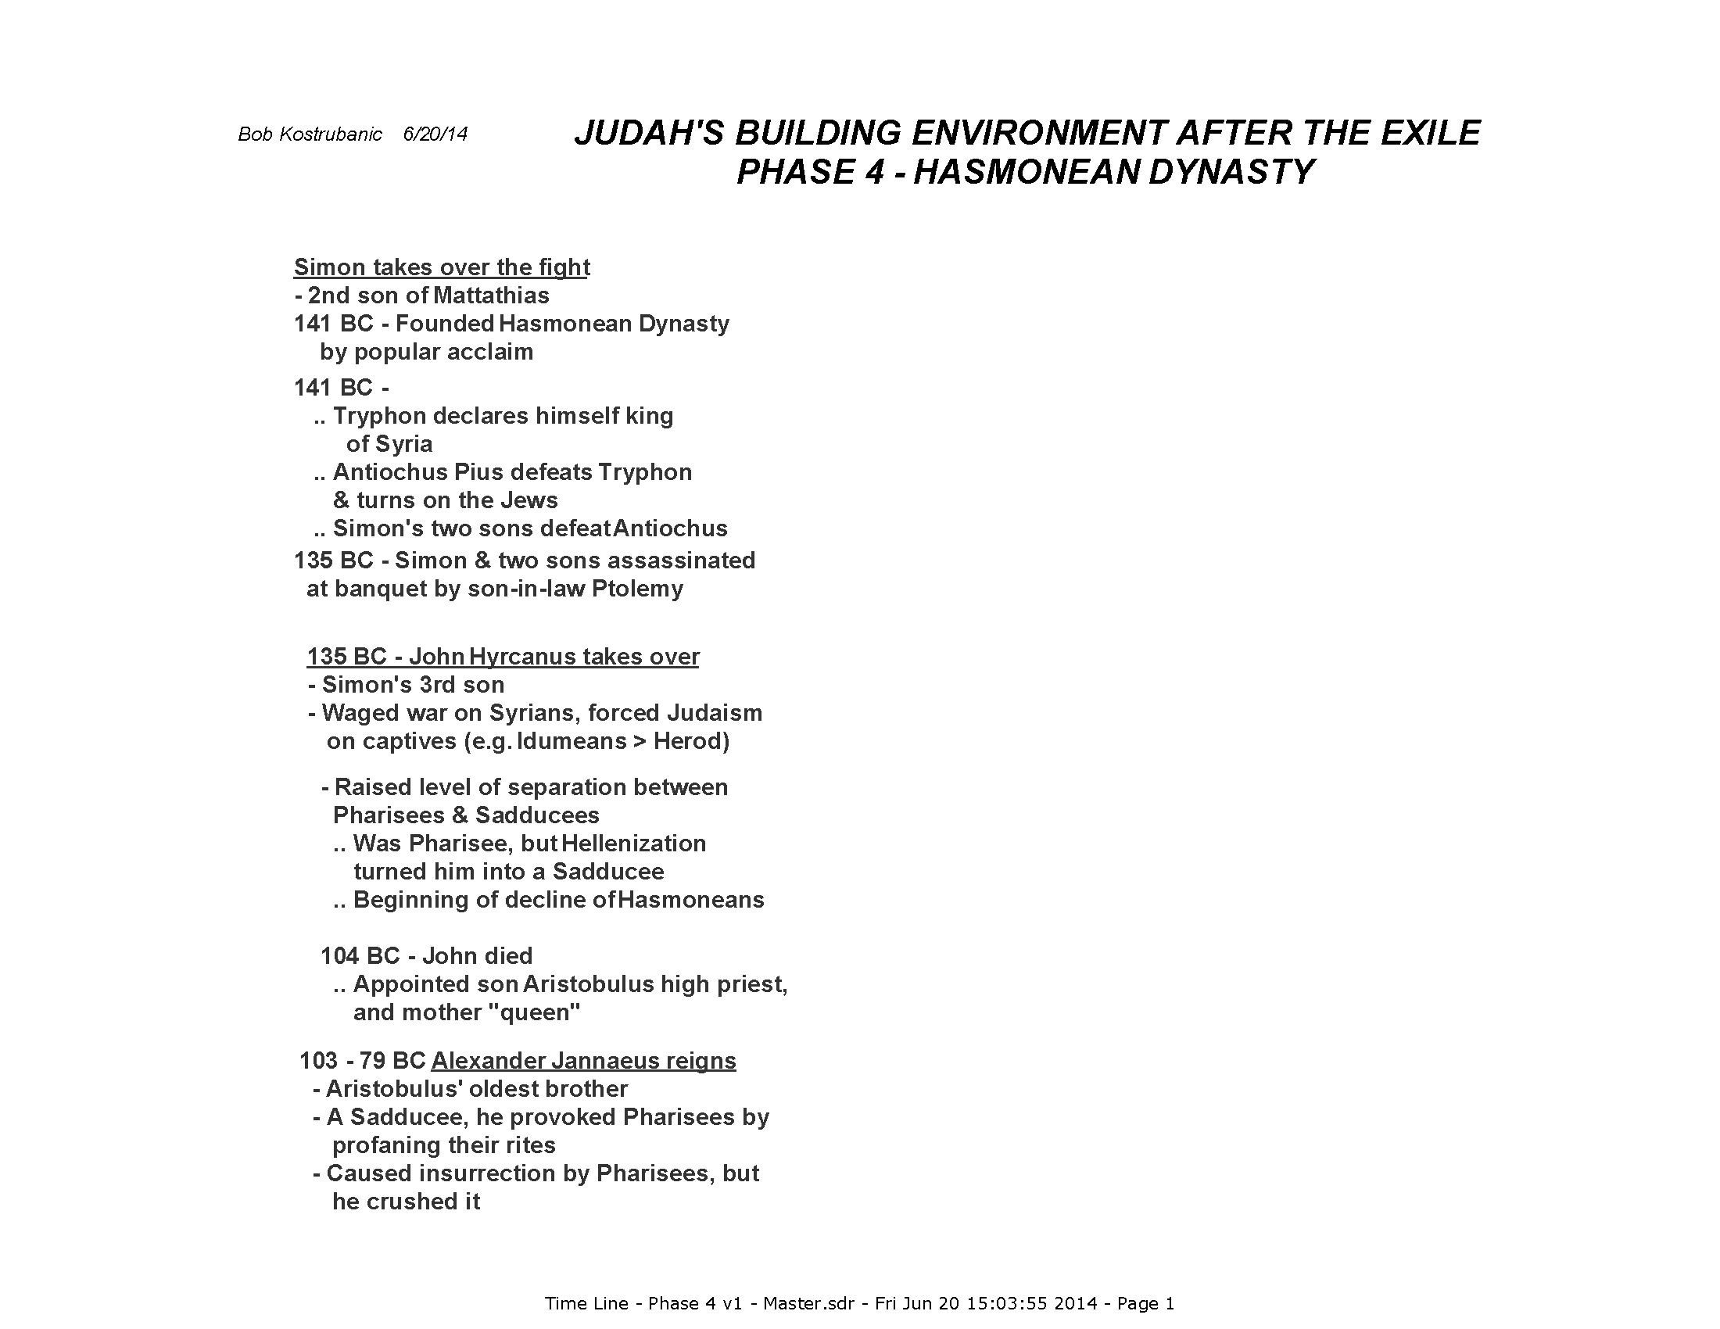

Slide 48
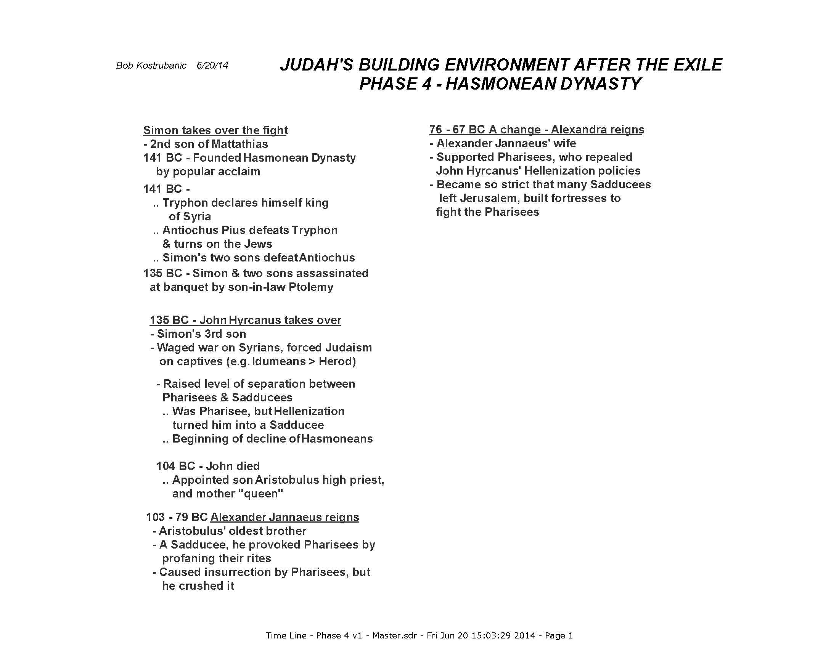

Slide 49
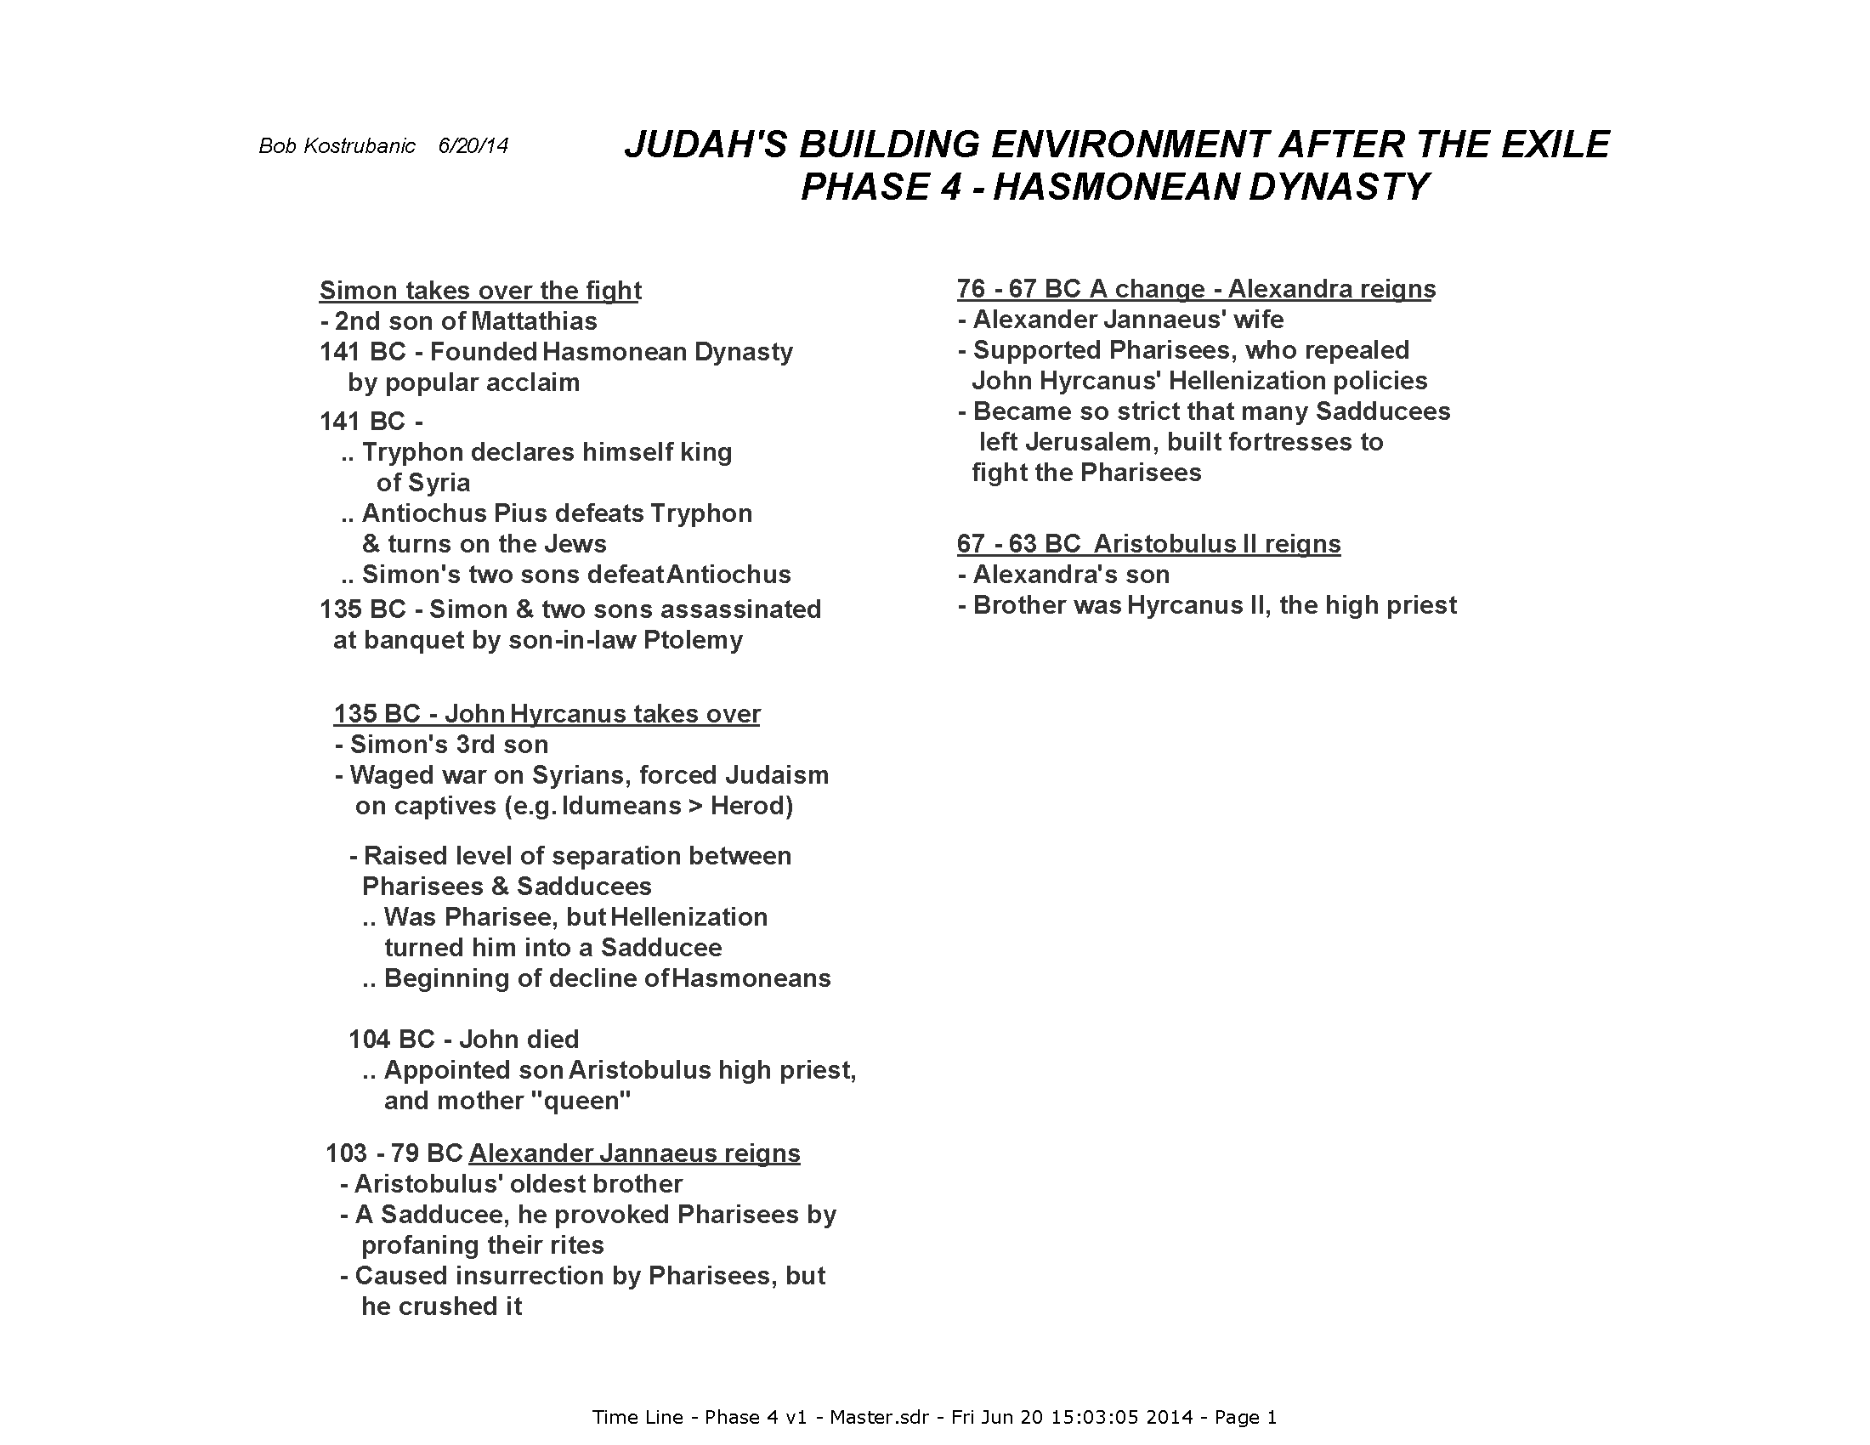

Slide 50
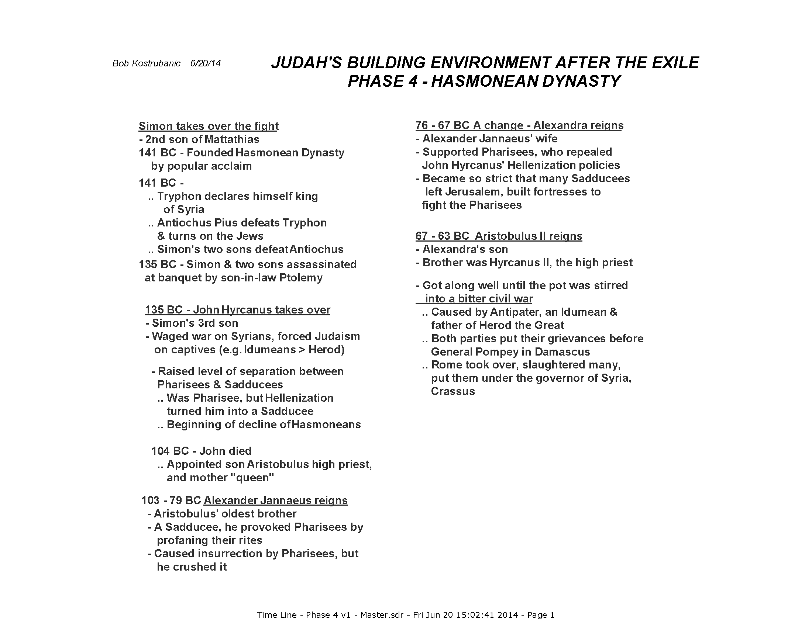

Slide 51
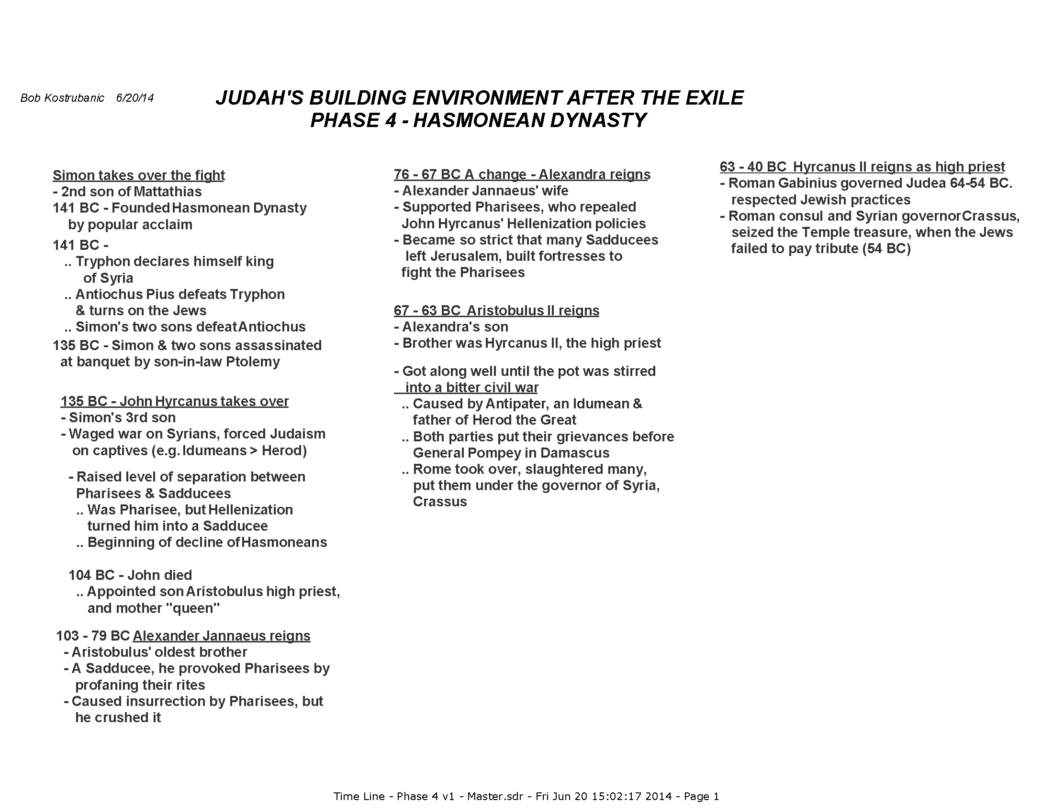

Slide 52
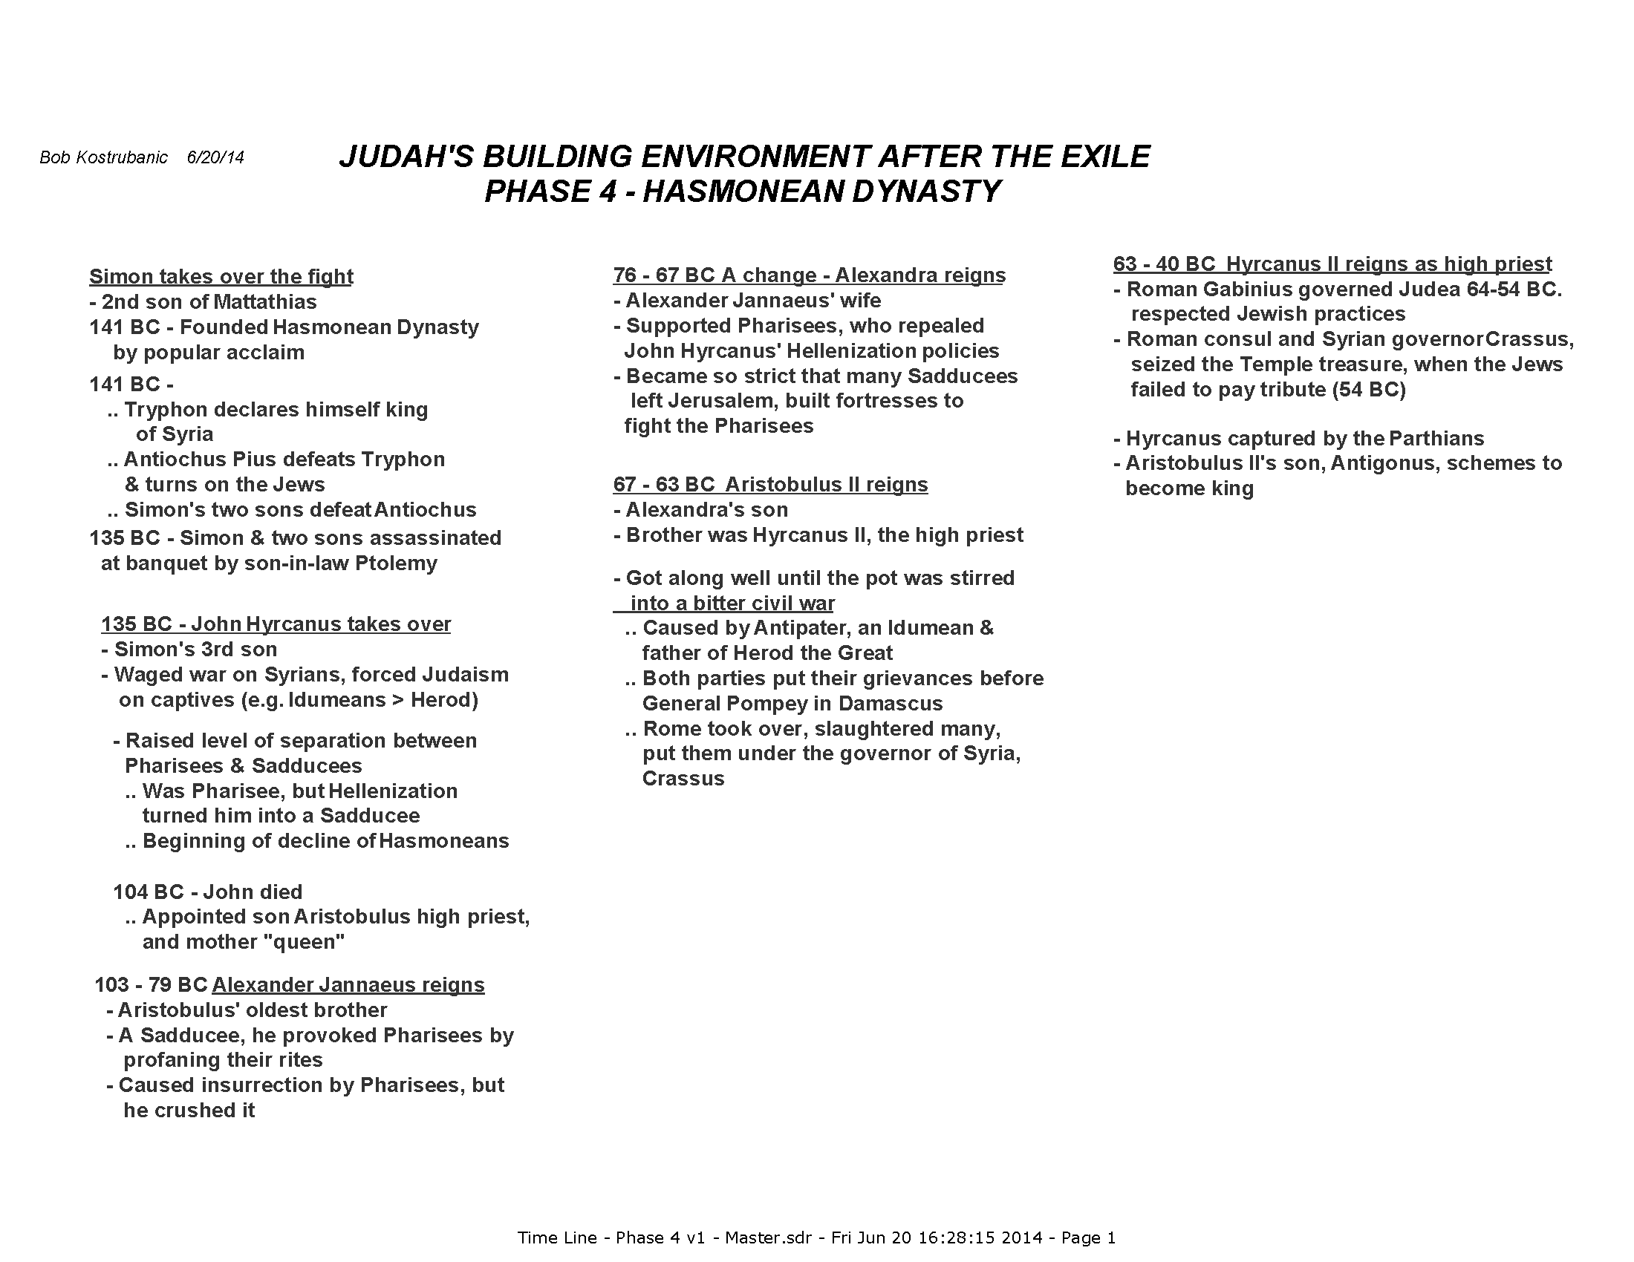

Slide 53


Slide 54


Slide 55
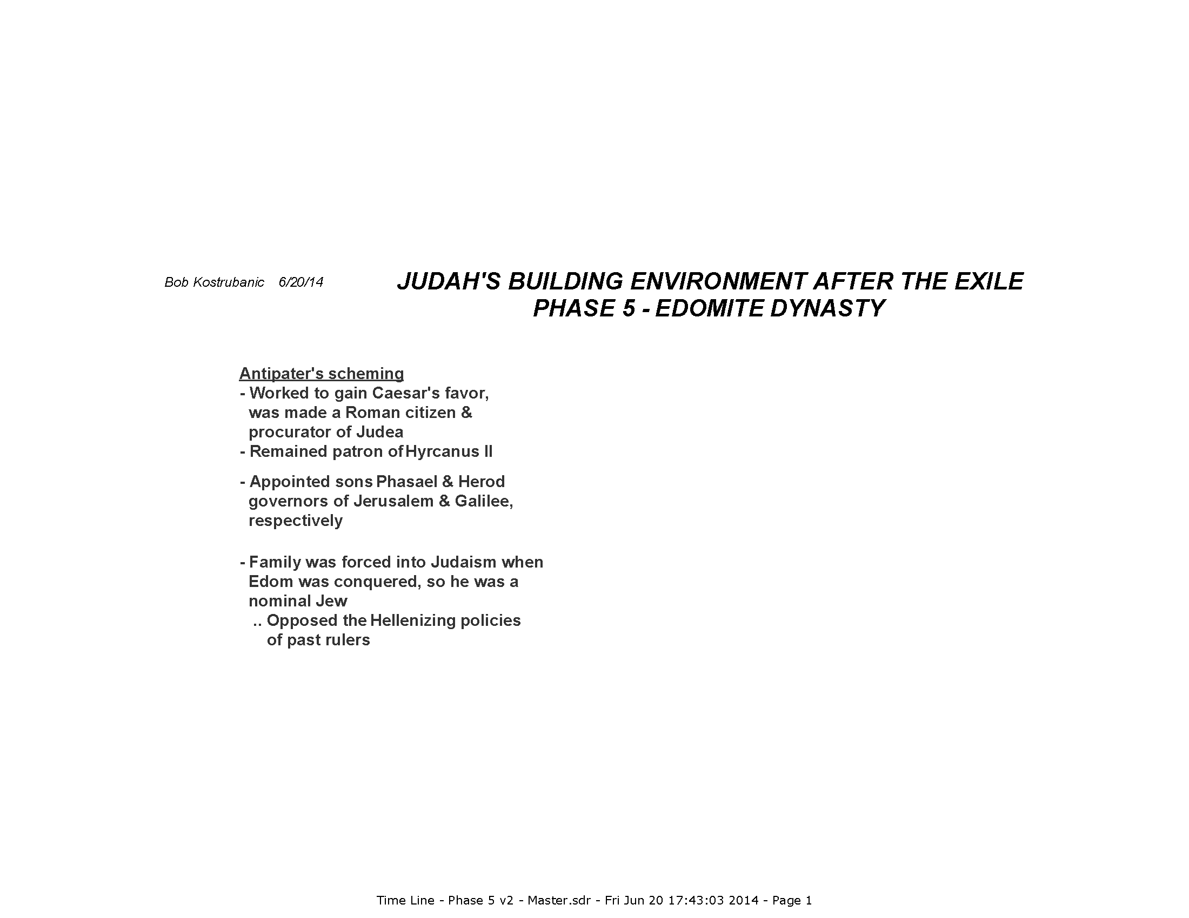

Slide 56
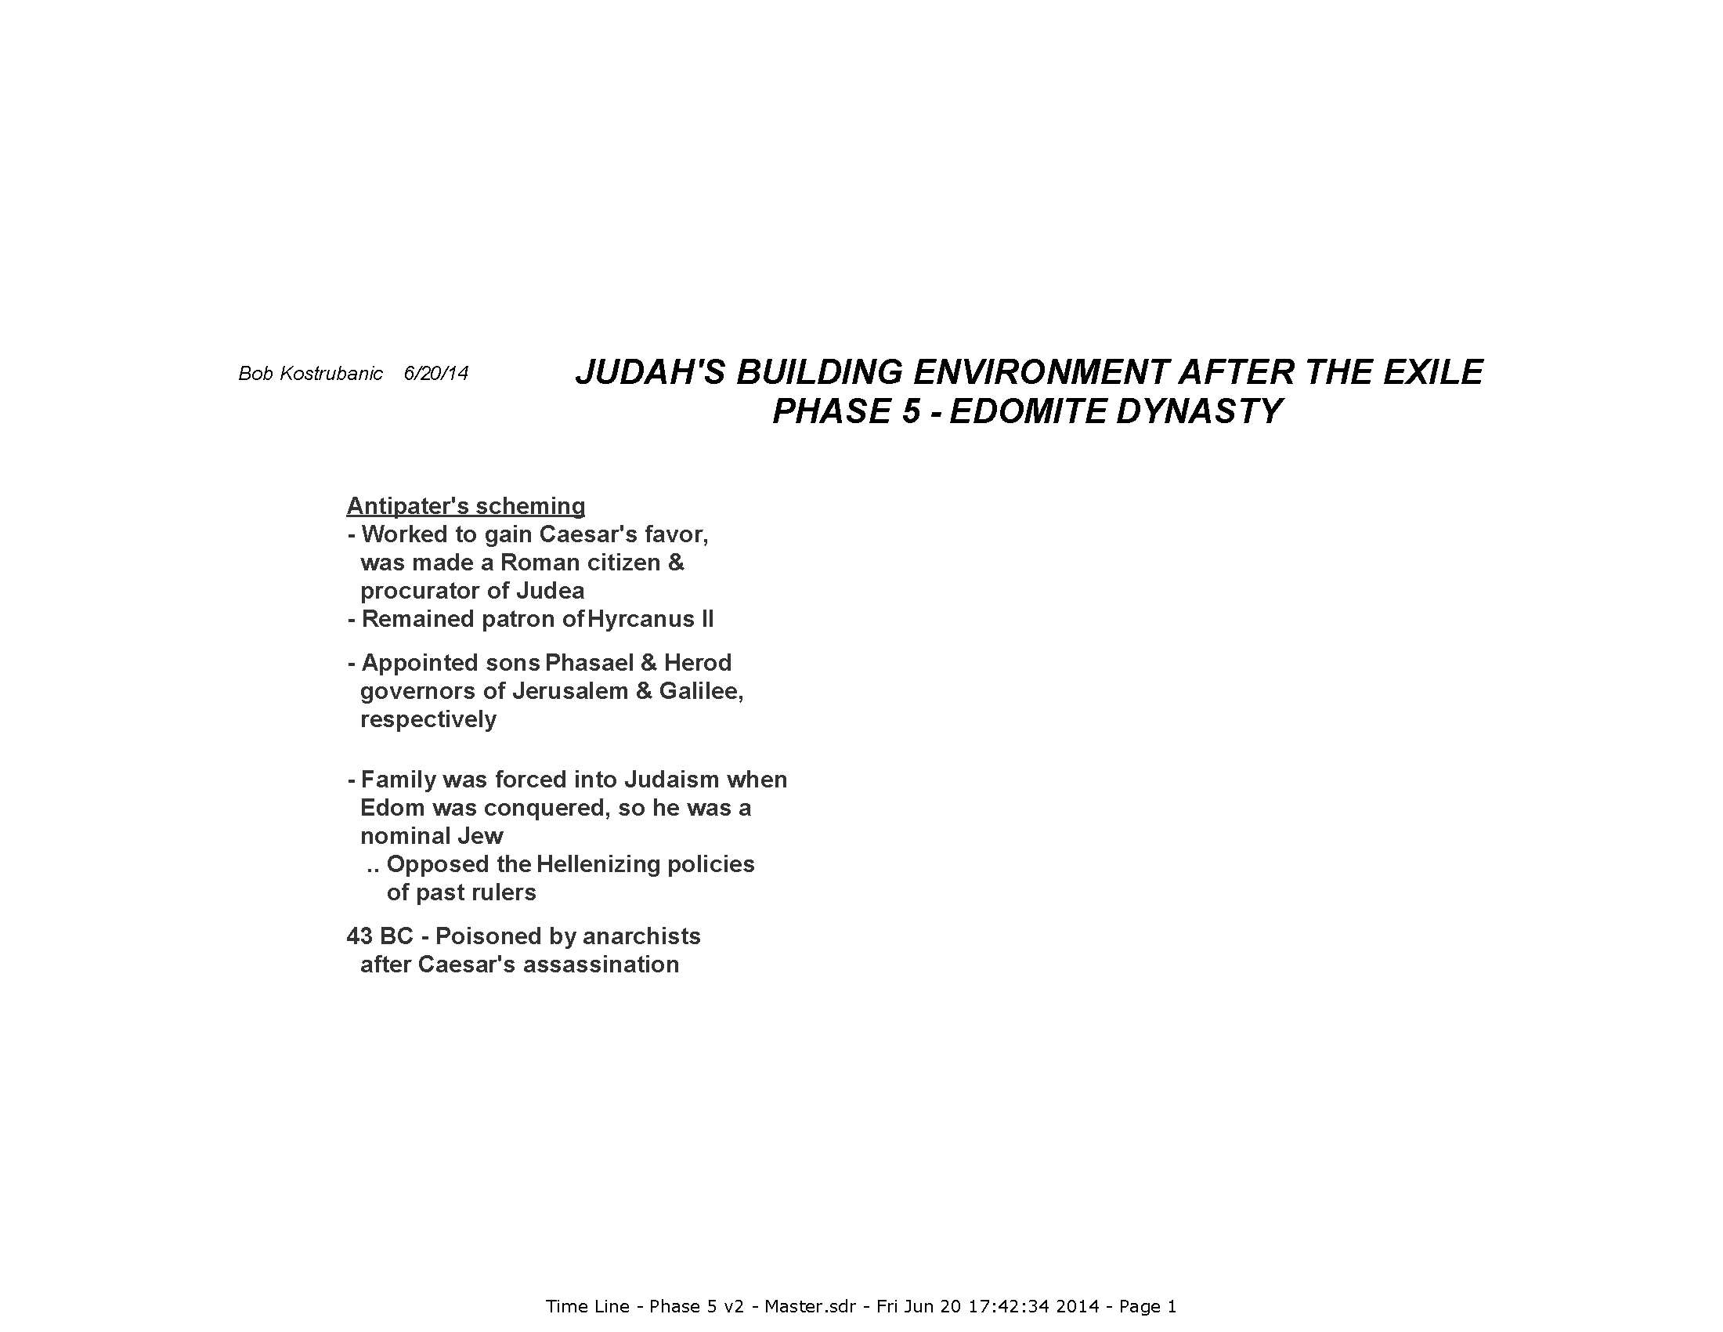

Slide 57
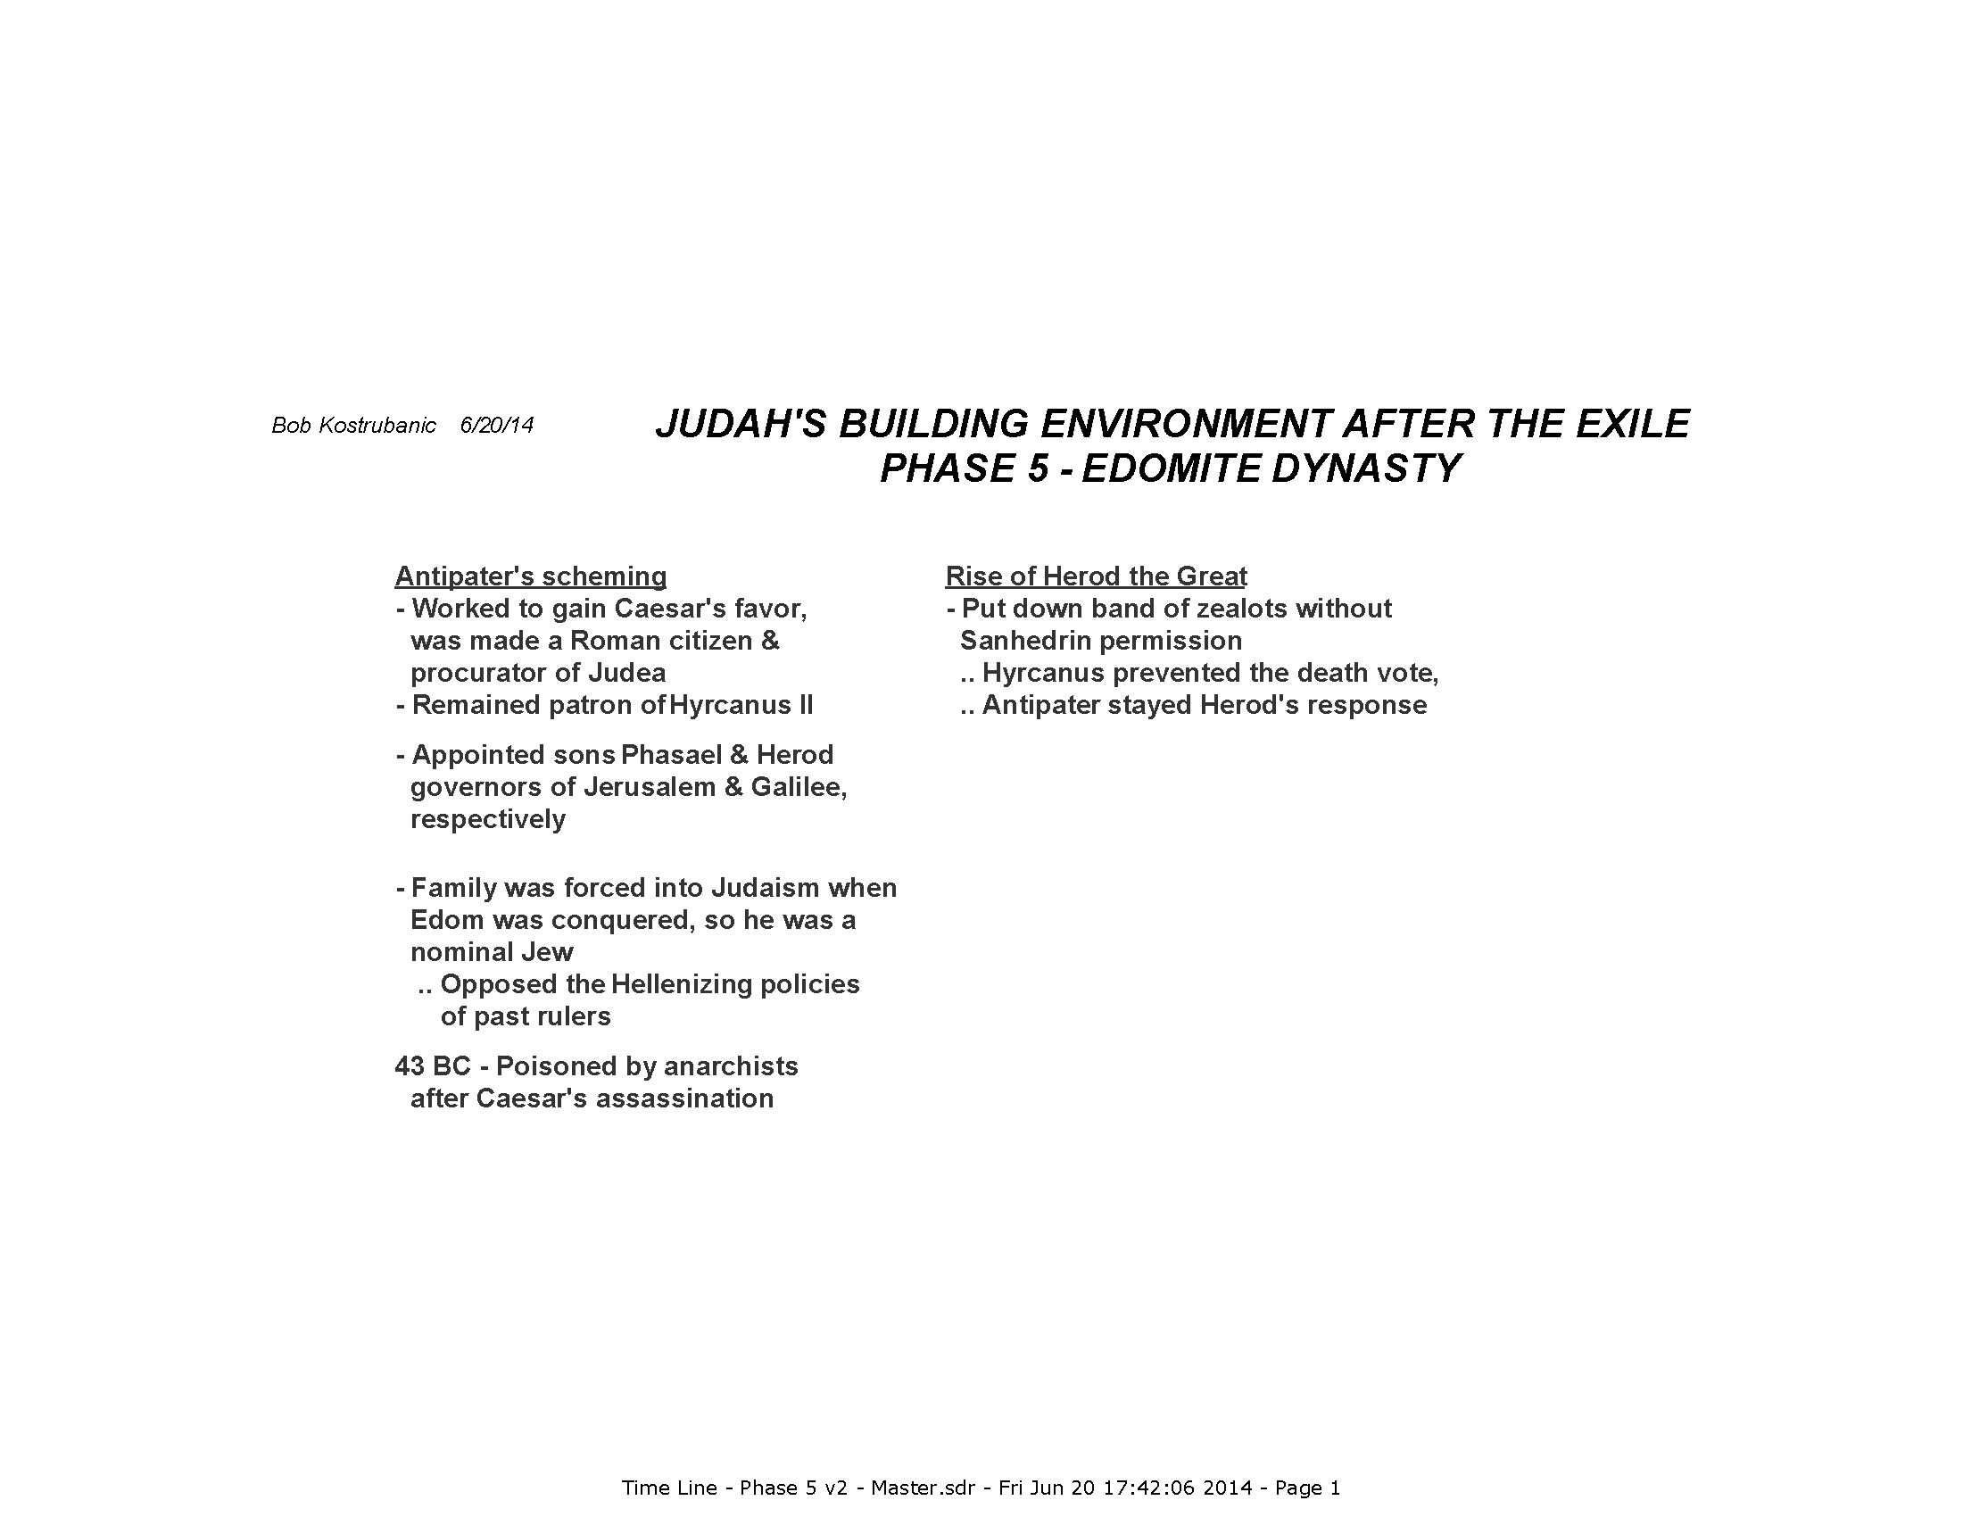

Slide 58
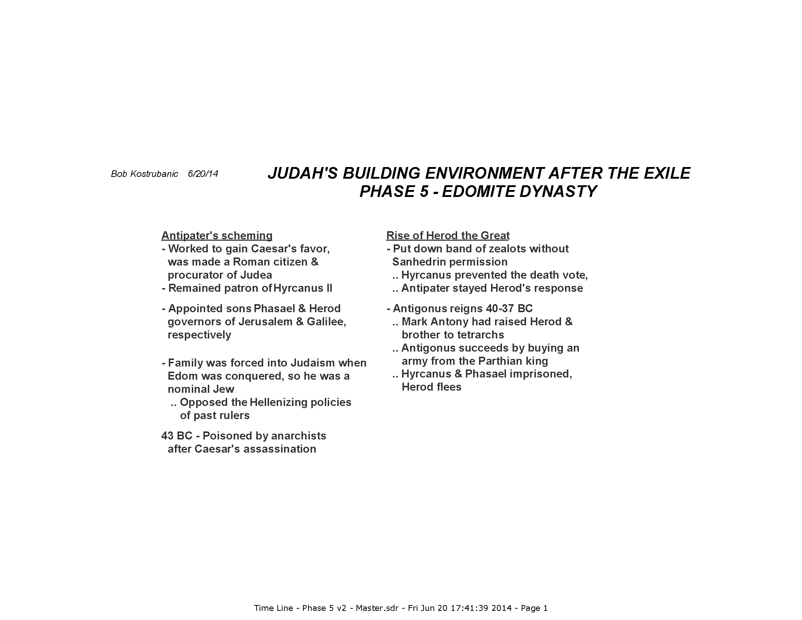

Slide 59
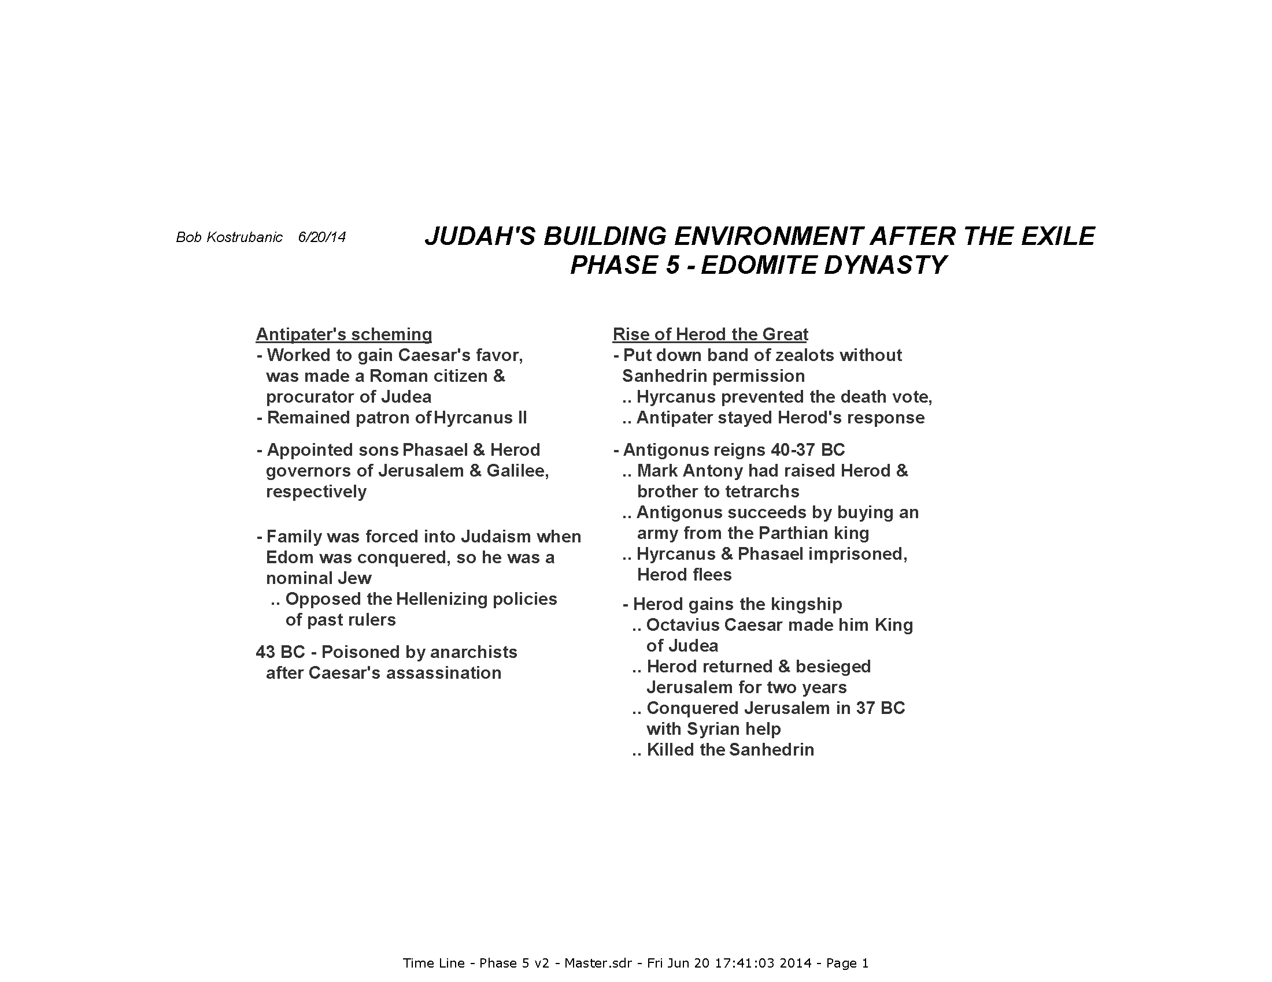

Slide 60
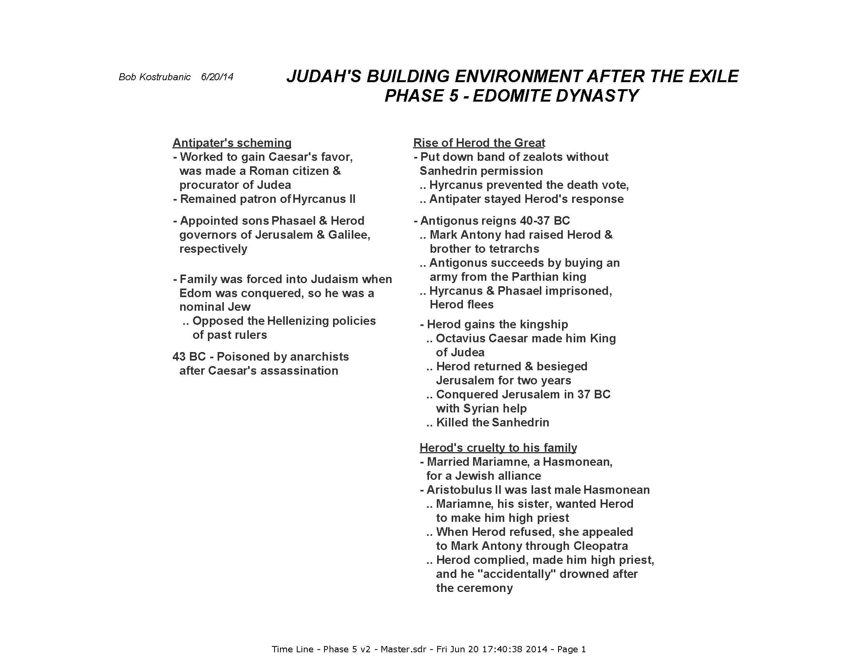

Slide 61
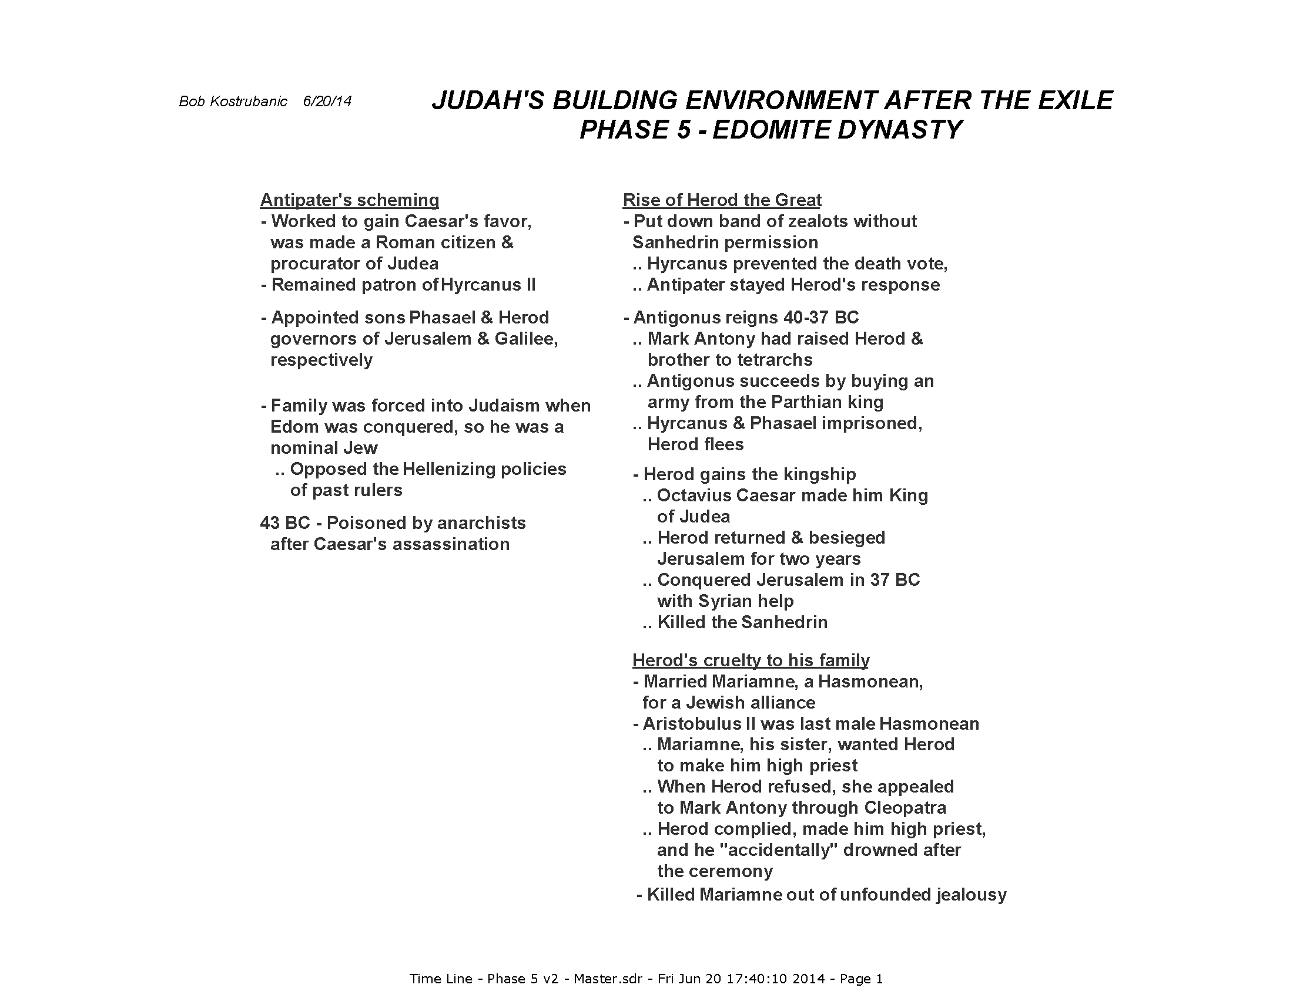

Slide 62
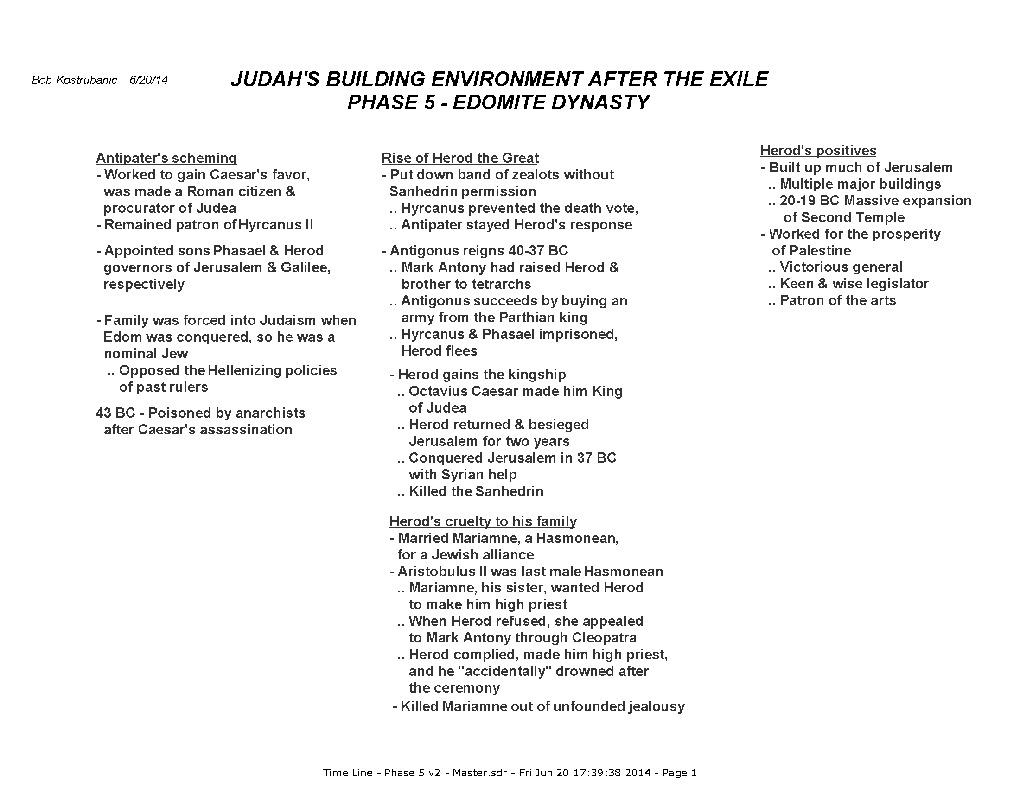

Slide 63
CONCLUSION
Summary of what brought down the returned Judeans
  Did not rely on God alone for all support
  Relied instead on alliances with worldly kingdoms, princes
  Became involved with the world’s politics
  Gave up God’s spiritual guidance for the intellectual and elitist ideals of contemporary society
  Zeph 1.4
“So I will stretch out My hand against Judah And against all the inhabitants of Jerusalem. And I will cut off the remnant of Baal from this place, And the names of the idolatrous priests along with the priests.”

Slide 64
CONCLUSION (cont’d)
This brought the dismal conditions Christ taught in
Long years of decline as a nation since David & Solomon
Spiritual leadership changed many times between the Pharisees & the high priest, declining from truth more each time
The impact of Hellenization fueled all of this
  Rising of world views above biblical views
  Acceptance of multiple religions alongside Judaism
  Elevation of worldly ambitions above serving God & mankind
  Dependence on governments, good or bad

Slide 65
CONCLUSION (cont’d)
So the people that Jesus came to teach God’s truth …
Had blind eyes, ears which couldn’t hear the truth
Hearts were hardened to God’s true ways by a long absence of spiritual teaching
Consciences seared by all the brutality they lived through
They looked for a true king to free them from oppressors again
  The root problem – the line of the Messiah didn’t come through the Hasmoneans
  The line of David was now in the lowest levels of society, so few expected to see the Messiah there
  They didn’t know the Scriptures as true prophecy anymore

Slide 66
CONCLUSION (cont’d)
J. Vernon McGee gave this formula for a national decline many years ago …
Spiritual apostasy
v v v
Moral depravity
v v v
Political anarchy
Where is America on this progression ??
Here’s a hint …
“The world has achieved brilliance without conscience. Ours is a world of nuclear giants and ethical infants.”
Omar Bradley, 1948

