Slide 1
GOD’S ATTRIBUTES
And what they mean to the believer

Slide 2
RELATIONSHIPS AMONG GOD'S ATTRIBUTES
SOLITARINESS (Uniqueness)
"Basic" Attributes
Universal
Results
HOLINESS
OMNISCIENCE
OMNIPRESENCE
OMNIPOTENCE
SUPREMACY
^{"Productive" Attributes} SOVEREIGNTY
IMMUTABILITY
Providing Quality of Life
LOVEGOODNESSMERCY
JUSTICE PATIENCE
WISDOM FAITHFULNESS
GRACE
To believers & unbelievers To believers, ONLY
Blackhawk Baptist
Church
Bob Kostrubanic
10/4/85
Rev. 8/12/94

Slide 3
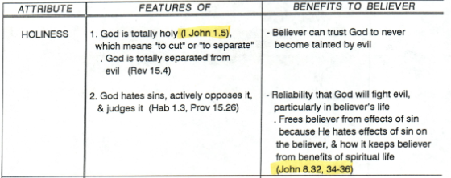
ATTRIBUTES OF GOD: Basic

Slide 4
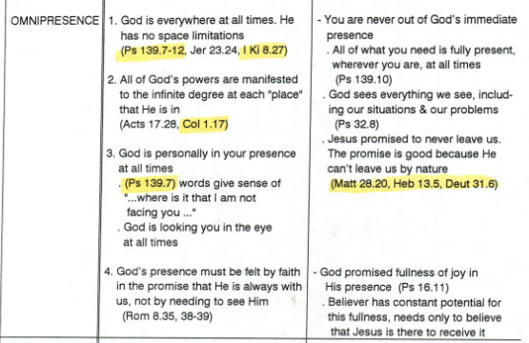
ATTRIBUTES OF GOD: Basic (cont’d)

Slide 5
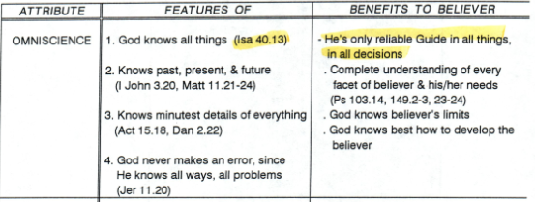
ATTRIBUTES OF GOD: Basic (cont’d)

Slide 6
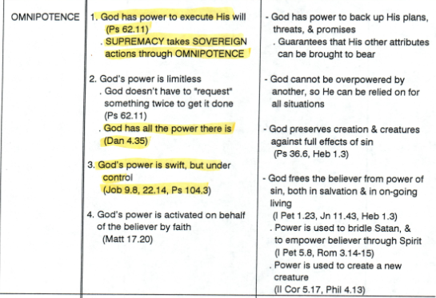
ATTRIBUTES OF GOD: Basic (cont’d)

Slide 7
RELATIONSHIPS AMONG GOD'S ATTRIBUTES
SOLITARINESS (Uniqueness)
"Basic" Attributes
Universal
Results
HOLINESS
OMNISCIENCE
OMNIPRESENCE
OMNIPOTENCE
SUPREMACY
^{"Productive" Attributes} SOVEREIGNTY
IMMUTABILITY
Providing Quality of Life
LOVEGOODNESSMERCY
JUSTICE PATIENCE
WISDOM FAITHFULNESS
GRACE
To believers & unbelievers To believers, ONLY
Blackhawk Baptist
Church
Bob Kostrubanic
10/4/85
Rev. 8/12/94

Slide 8
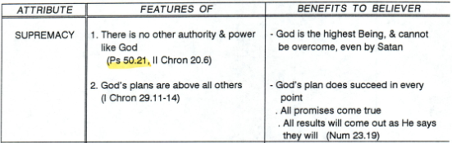
ATTRIBUTES OF GOD: Universal Results

Slide 9
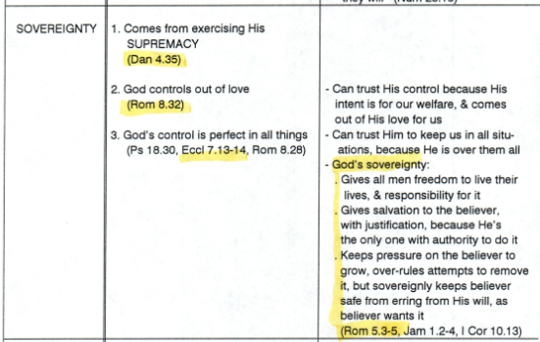
ATTRIBUTES OF GOD: Universal Results (cont’d)

Slide 10
RELATIONSHIPS AMONG GOD'S ATTRIBUTES
SOLITARINESS (Uniqueness)
"Basic" Attributes
Universal
Results
HOLINESS
OMNISCIENCE
OMNIPRESENCE
OMNIPOTENCE
SUPREMACY
^{"Productive" Attributes} SOVEREIGNTY
IMMUTABILITY
Providing Quality of Life
LOVEGOODNESSMERCY
JUSTICE PATIENCE
WISDOM FAITHFULNESS
GRACE
To believers & unbelievers To believers, ONLY
Blackhawk Baptist
Church
Bob Kostrubanic
10/4/85
Rev. 8/12/94

Slide 11
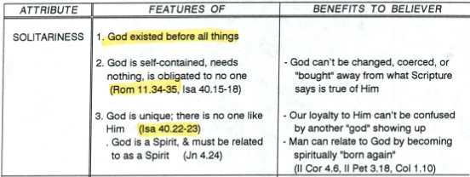
ATTRIBUTES OF GOD: Essence

Slide 12
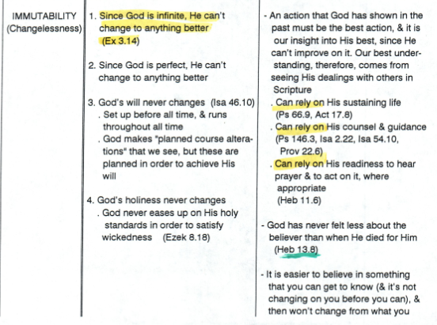

ATTRIBUTES OF GOD: Essence (cont’d)

Slide 13
RELATIONSHIPS AMONG GOD'S ATTRIBUTES
SOLITARINESS (Uniqueness)
"Basic" Attributes
Universal
Results
HOLINESS
OMNISCIENCE
OMNIPRESENCE
OMNIPOTENCE
SUPREMACY
^{"Productive" Attributes} SOVEREIGNTY
IMMUTABILITY
Providing Quality of Life
LOVEGOODNESSMERCY
JUSTICE PATIENCE
WISDOM FAITHFULNESS
GRACE
To believers & unbelievers To believers, ONLY
Blackhawk Baptist
Church
Bob Kostrubanic
10/4/85
Rev. 8/12/94

Slide 14
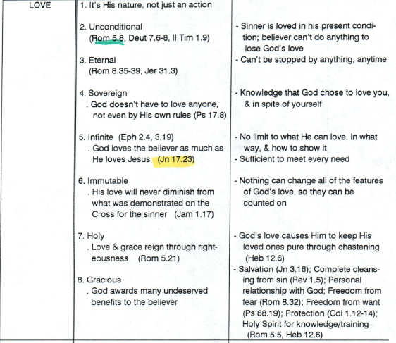
ATTRIBUTES OF GOD: Quality Life to All

Slide 15
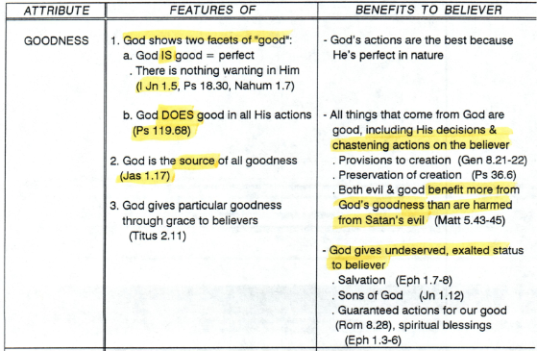
ATTRIBUTES OF GOD: Quality Life to All (cont’d)

Slide 16
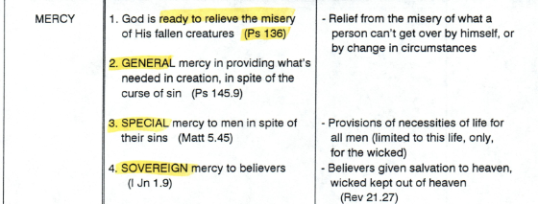
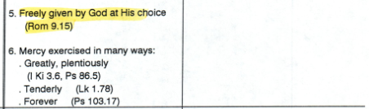
ATTRIBUTES OF GOD: Quality Life to All (cont’d)

Slide 17
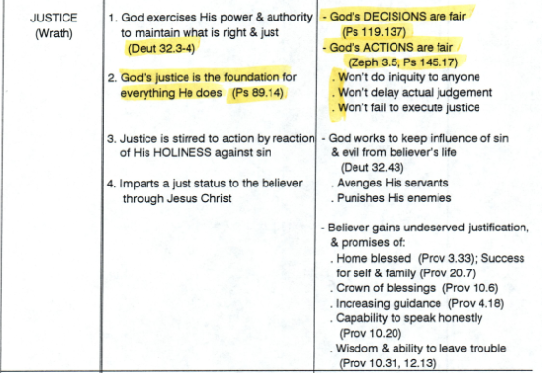
ATTRIBUTES OF GOD: Quality Life to All (cont’d)

Slide 18
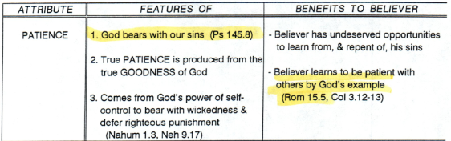
ATTRIBUTES OF GOD: Quality Life to All (cont’d)

Slide 19
RELATIONSHIPS AMONG GOD'S ATTRIBUTES
SOLITARINESS (Uniqueness)
"Basic" Attributes
Universal
Results
HOLINESS
OMNISCIENCE
OMNIPRESENCE
OMNIPOTENCE
SUPREMACY
^{"Productive" Attributes} SOVEREIGNTY
IMMUTABILITY
Providing Quality of Life
LOVEGOODNESSMERCY
JUSTICE PATIENCE
WISDOM FAITHFULNESS
GRACE
To believers & unbelievers To believers, ONLY
Blackhawk Baptist
Church
Bob Kostrubanic
10/4/85
Rev. 8/12/94

Slide 20
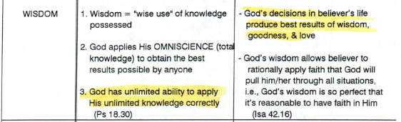
ATTRIBUTES OF GOD: Quality Life to Believers

Slide 21
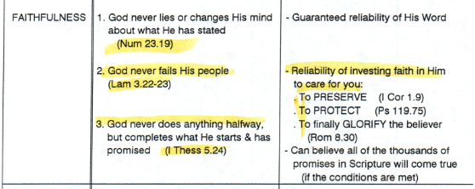
ATTRIBUTES OF GOD: Quality Life to Believers
(cont’d)

Slide 22
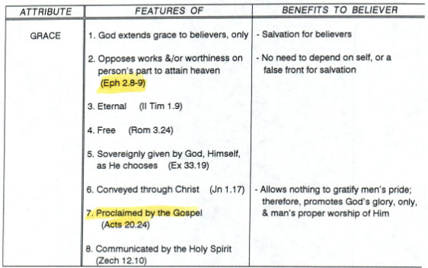
ATTRIBUTES OF GOD: Quality Life to Believers
(cont’d)

